Slide 1
REGIONAL SCM MEETING BRIEF on GAMBIA’S DEMO SITE activities
Abubacarr Kujabi
Demo Site Coordinator

Slide 2
Presentation outline
Main Project Activities
Implementation update
Planned activities
Challenges faced
Results achieved
Recommendations

Slide 3
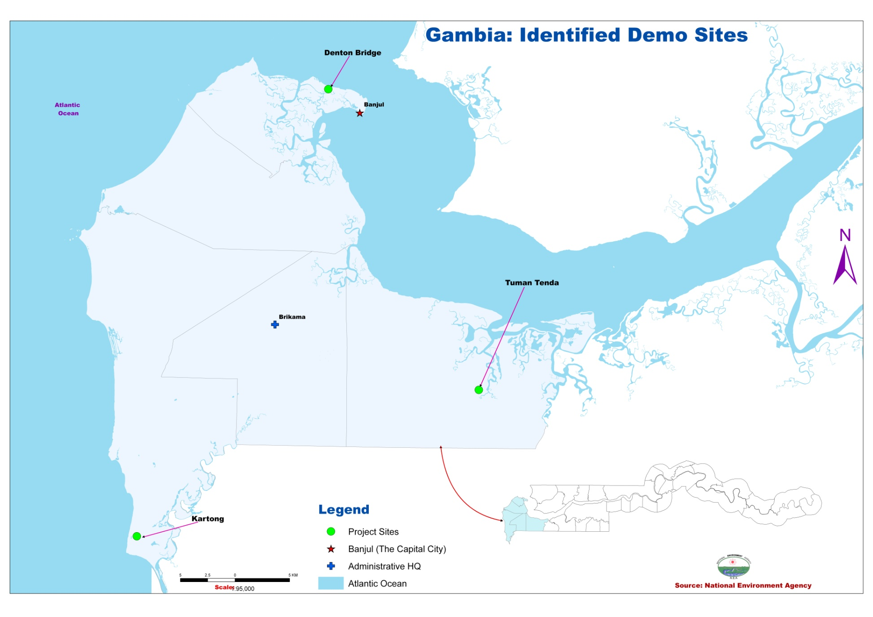

Slide 4
Objectives
To develop new and sustainable community based tourism activities and (SMMEs) in line with ecotourism development goals and create pro-poor tourism opportunities for the community of Kartong.

Slide 5
Main Project Activities
Training of local people on environmental issues in order to protect the marine and coastal ecosystems (20)
Train the trainers for capacity building in the community (6 KART and VDC)
Triathlon and awareness raising activities organized during Kartong Cultural Festival

Slide 6
Main Project Activities cont.
Integrate coastal protection into the KART Responsible Tourism Policy through community consultation 30 participants
Tesito camp developed into campsite with tourist facilities
Conduct a familiarization trip with local and international tour operators in order to expand the market to more operators for the South Gambia cross-village excursion
Public private partnership planning

Slide 7
Main Project Activities cont.
Enhance the Sandale craft showcase by introducing new craft products such as pottery as well as building workshops and points of sale for Kartong artists
Purchase 10 bicycles to introduce more environmentally friendly activities such as village cycling with the view to hire bikes to visitors at the following locations: Sandele, Halahin Camp and the KART Tourists Information Office
GIS consultancy for the production of series of maps of Kartong Demo Site of the COAST

Slide 8
Main Project Activities cont.
Conduct a training program on guiding with 10 youths from Kartong who will be doing the bicycle tour as well as the village walking tour
Rehabilitation and fencing of of the Folonko crocodile pool to keep intruding animals away and introduce an entrance fee to the sacred site
Purchase 20 waste bins for project tourist attractions (10 bins for degradable waste and another ten with a different colour for non-degradable waste.

Slide 9
Main Project Activities cont.
Train 25 women and men on waste recycling into manure and craft
Conduct a training program on the business and administration skills
Purchase and setting up of a computer and a printer and stationeries for KART as well as acquiring energy source i.e. a solar system that will assure the good functioning of the equipment

Slide 10
Implementation update:
A National Project Steering Committee established
Demo Site management Committee established
Visit of the TNA Consultant to Demo Sites and meetings with relevant stakeholders.
Governance and Management Consultancy executed.
BAPs and BATs baseline data Consultancy executed

Slide 11
Implementation update Cont.
Community Visioning exercise executed
Awareness raising to encourage enforcement of natural resource sustainable use within TDA and in protected areas executed in Gunjur
500 copies of brochures printed and distribute
International Coastal Cleanup
Launching of the Ecotourism Component of the COAST Project held on the 15th February 2013

Slide 12
Implementation update Cont.
Purchased and delivered 20 waste bins and 10 bicycles to the community of Kartong
Responsible Tourism Training conducted from the 1st to the 3rd February 2013
10 bicycles purchased to introduce more environmentally friendly activities
Training on Business and Administration skills in the areas of record keeping, customer service, IT, food hygiene and business management executed in April 2013

Slide 13
Implementation update Cont.
GIS consultancy for the production of series of maps of Kartong Demo Site of the COAST Project completed
Trained 20 members on environmental issues in order to protect the marine and coastal ecosystem conducted from the 12th to the 14th April 2013.
Tour guide training consultancy for 10 youths in Kartong conducted inApril 2013

Slide 14
Implementation update Cont.
Developing Tesito Camp into a camping site with facilities like toilets, showers and proper waste disposal arrangements as well as introduce activities such as Gambian cookery classes with the village women in progress
Enhance the Sandale craft showcase by introducing new craft products such as pottery as well as building workshops and points of sale for Kartong artists in progress

Slide 15
Implementation update Cont.
25 women and men trained on waste recycling into manure and craft
computer and a printer for KART purchased as well as a solar system that will assure the good functioning of the equipment
Stakeholders assessment workshop conducted on the 22nd April 2013
Biodiversity training conducted from the 23 – 25 April 2013

Slide 16
Planned Activities
Train the trainers for capacity building in the community (6 KART and VDC)
Triathlon and awareness raising activities organized during Kartong Cultural Festival
Integrate coastal protection into the KART Responsible Tourism Policy through community consultation 30 participants
Tesito camp developed into campsite with tourist facilities

Slide 17
Planned Activities
Conduct a familiarization trip with local and international tour operators in order to expand the market to more operators for the South Gambia cross-village excursion
Public private partnership planning
Enhance the Sandale craft showcase by introducing new craft products such as pottery as well as building workshops and points of sale for Kartong artists

Slide 18
Challenges faced
Fencing of folonko
Having numerous training activities during the rainy season
Having trainings outside Kartong

Slide 19
Results achieved
Improved tree planting in the community
Community forest better protected than before
Waste management improved
Income generation through bicycle hiring and contribute to the financial transactions of KART and the VDC
Ease the mobility of KART executives during meetings

Slide 20
Results achieved cont.
Improve the crude method of tourist guides
Economic gain through tips from tourists
Community members are now engaged in recycling nylons to wallets
Waste reduction through trainings and provision of bins

Slide 21
Results achieved cont.
Food hygiene improved
Proper record keeping at KART and Tesito
A well functioning KART office (save income typing 22km)
Helps improve code of dressing and promote culture and norms

Slide 22
Recommendations
.
Constant consultation between development partners and the beneficiaries
Frequent and adequate trainings necessary especially on Environmental issues
A three year plan that is income generation oriented and environmentally friendly needed.

Slide 23
THANK YOU

