Slide 1
6th STEERING COMMITTEE MEETING Mahe, Seychelles 11-14 June, 2014 EMS Thematic Component UNIDO TEST Methodology Implementation RESULTS FOR Kenya, Mozambique, Senegal, Tanzania (SCM Day 2: 12 June 2014)

Slide 2
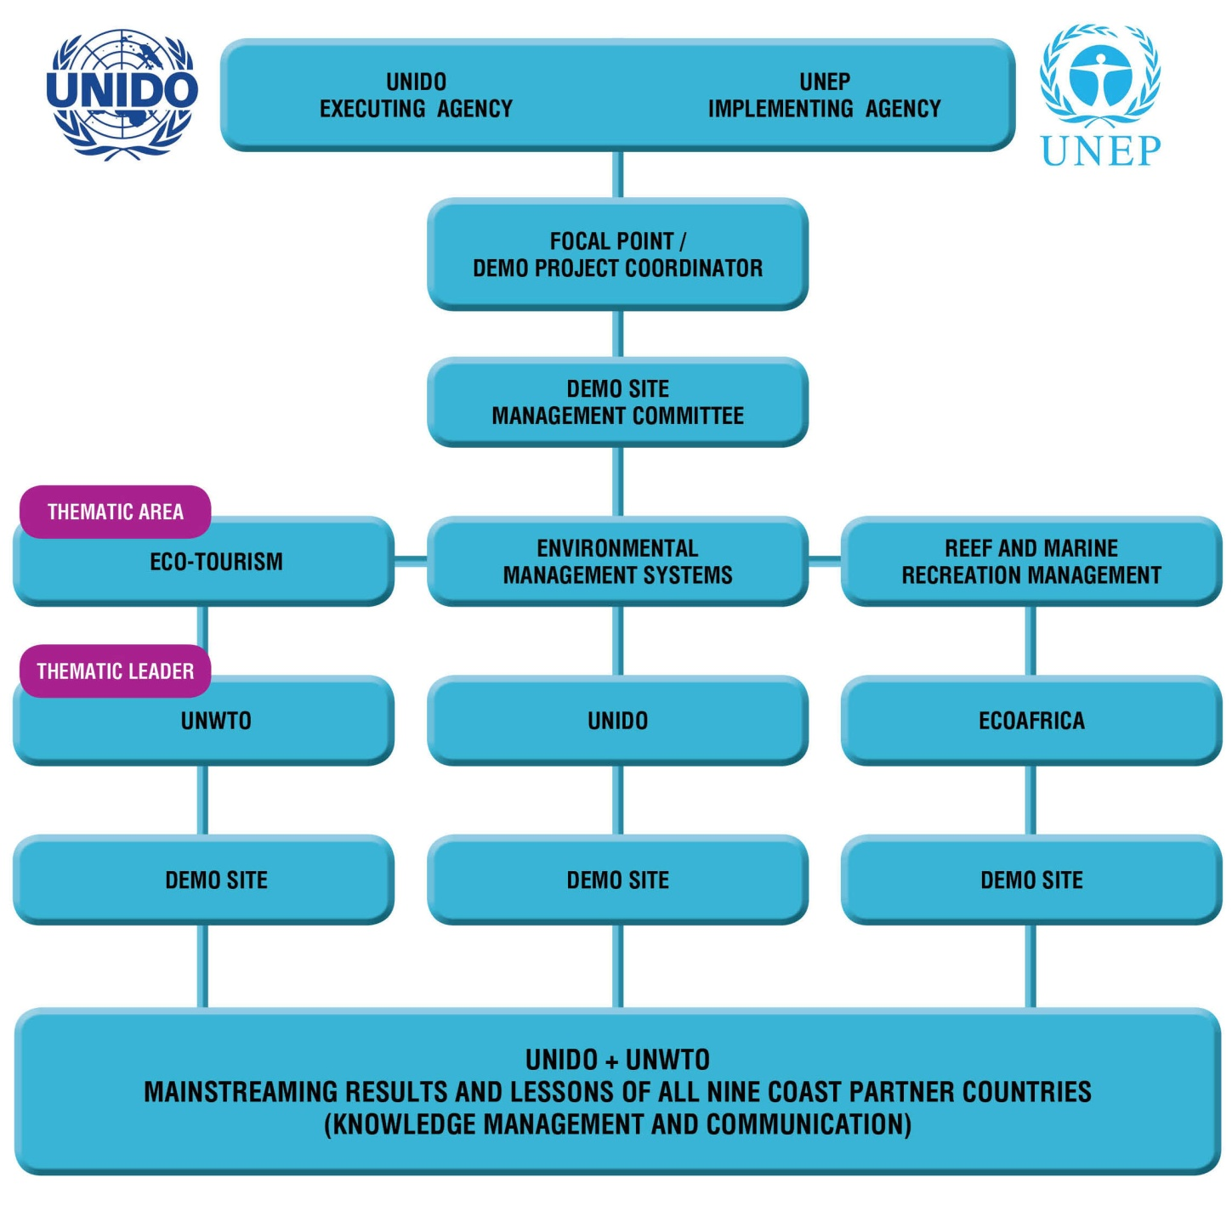

Slide 3
UNIDO led the implementation of the Transfer of Environmentally Sound Technology methodology (TEST) to the local hotel sector
in four of the COAST project countries:
Watamu, KENYA
Inhambane, MOZAMBIQUE
Saly, SENEGAL
Bagamoyo,TANZANIA
The first TEST trainings were held across the four EMS countries in
November/December 2012 for the hotel sector, DPC and local experts.

Slide 4
Overview of the 5 TEST Management Tools implemented
TEST consists in introducing 5 Management Tools at company/industry level with the aim to change the management practices in a holistic manner in order to ensure the sustainable introduction of green practices.
1. CPA: Cleaner Production Assessment
2. EMA: Environmental Management Accounting
3. EMS: Environmental Management Systems
4. EST: Environmentally Sound Technology
5. CSR: Corporate Social Responsibility

Slide 5
Implementation framework of the 5 TEST Management Tools across the 4 countries
TEST Tool | KENYA | MOZAMBIQUE | TANZANIA | SENEGAL | OUTPUTS
Tool 1. CPA | *KNCPC | *MNCPC | *CPCT | Individual Experts | “No Cost and Low Cost“ recommendations
Tool 3. EMS |  |  |  |  | New systems of operation
Tool 5. CSR |  |  |  |  | Improved internal and external CSR
Tool 2. EMA | UNIDO expert |  |  |  | Reduction of waste
Tool 4. EST | UNIDO/ Private-Public Partnerships |  |  |  | Business and community benefits
*National Cleaner Production Centres

Slide 6
Rationale of partnering with NCPCs and National EMS/TEST experts
In partnering with nationally established institutions and experts one is ensuring:
that the best available national and local expertise is being applied and built upon local conditions rather than using only International expertise that may not be so well versed in national and local key information required to obtain more accurate and effective results that have a high replication potential
to ensure, especially given the very short available implementation timeline, that the beneficiaries have partners and experts to liaise with and go to after the closure of the COAST project.

Slide 7
Overview of EST in the four participating countries
COUNTRY | EST | BRIEF DESCRIPTION
Kenya | Rocket Composter (1 unit) | Input: Organic waste; Output: Compost Process: Fast process of composting through microbial/fungal growth
 | Flexi Biogas System (3 units) | Input: Organic waste; Output: Biogas Process: Production of biogas through hotel organic waste inoculated by organic waste from butchery and cow dung
 | Waste Bins (85 units) | Process: Use as collecting vessels strategically placed in various waste hotspots
Mozambique | Artisanal Glass Cutting Equipment (15 units) | Input: Solid waste; Output: Various artisanal products Process: Collection and recycling of solid waste
Senegal | Composting Equipment (1 unit) | Input: Organic waste; Output: Compost
Tanzania | Solar Street Lamps (20 units) | Input: Solar energy; Output: Light

Slide 8
Operational Implementation Budget from the Country contracts
Country | Country contract contribution to TEST
 | Contract Value (A)* | TEST Expenditure contract value (B+C+D)* | NCPC MOU / National Consultants (B)* | EST Contribution (C)* | Other TEST expenditures (D)*
Kenya | 102,498 | 52,746 | 19,000 | 33,746 | NA
Mozambique | 75,949 | 19,712 | 14,500 | 5,121 | NA
Senegal | 106,499 | 75,003 | 53,167 | 11,366 | 10,470
Tanzania | 109,248 | 76,514 | 22,500 | 53,021 | 993
* Values in USD

Slide 9
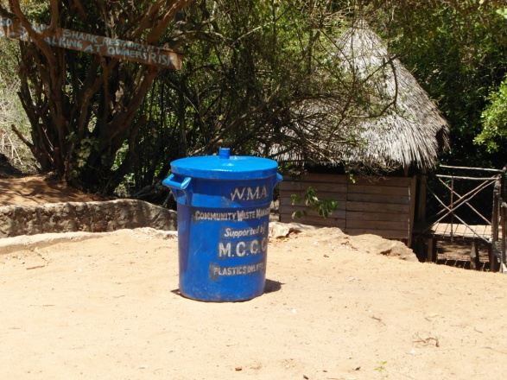
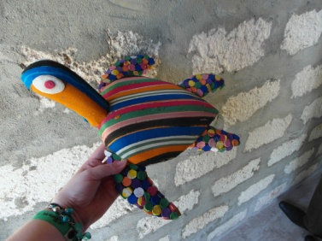
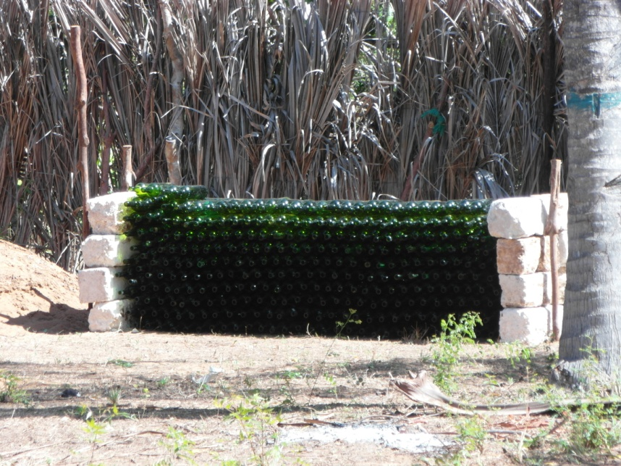
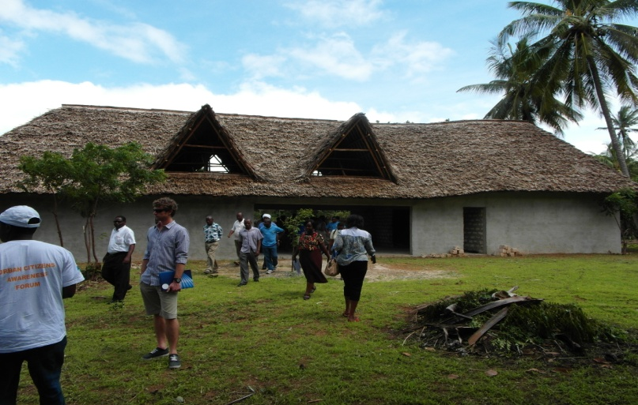
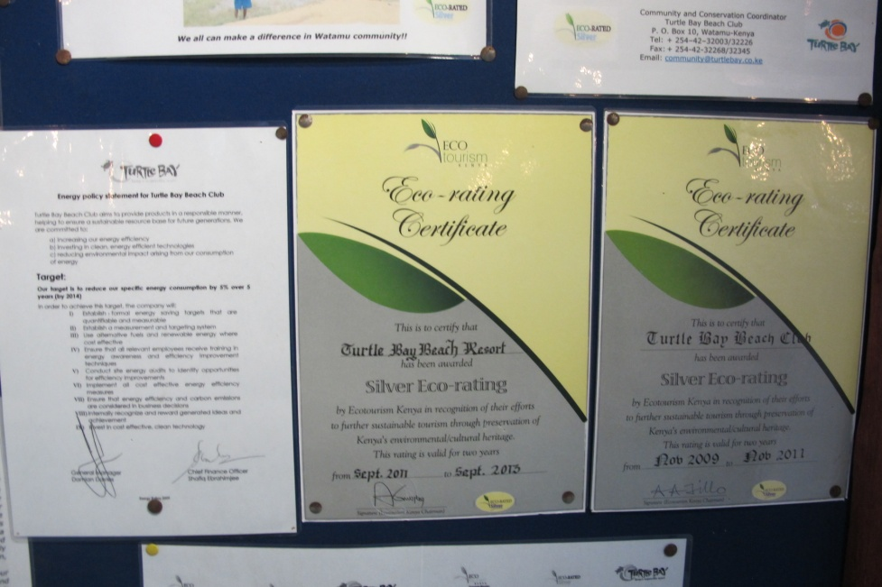
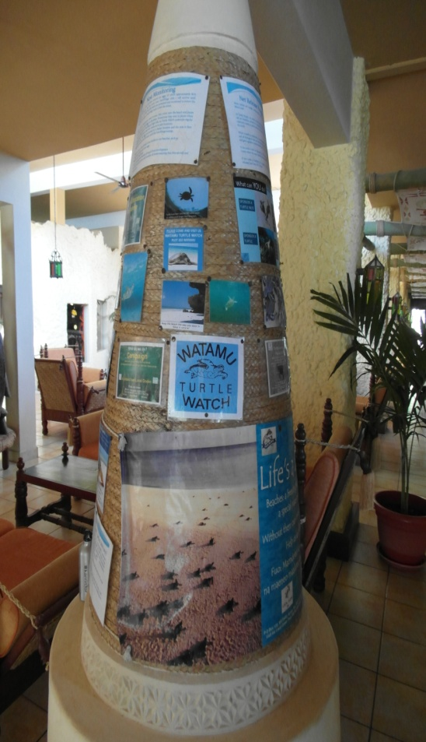
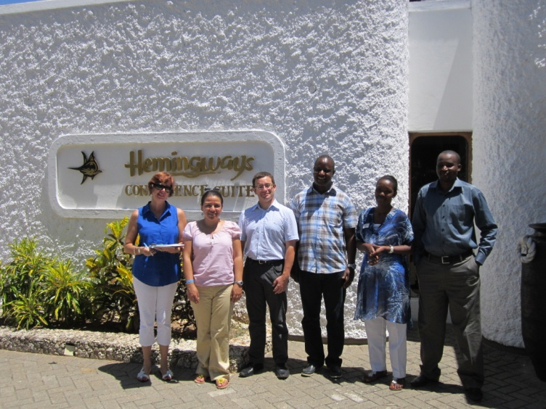
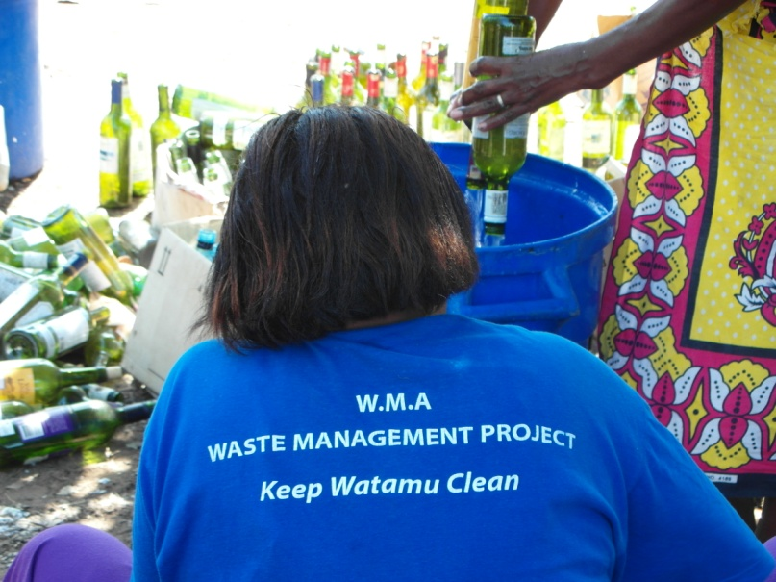
KENYA TEST Implementation

Slide 10
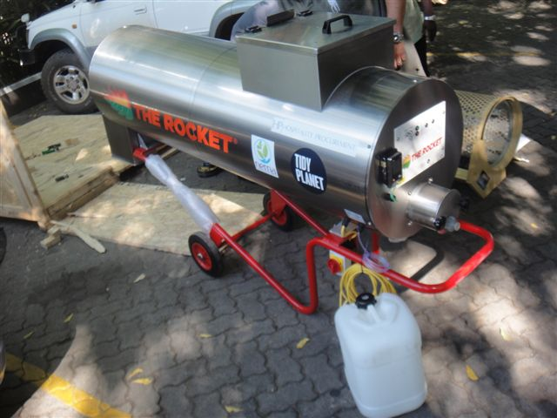
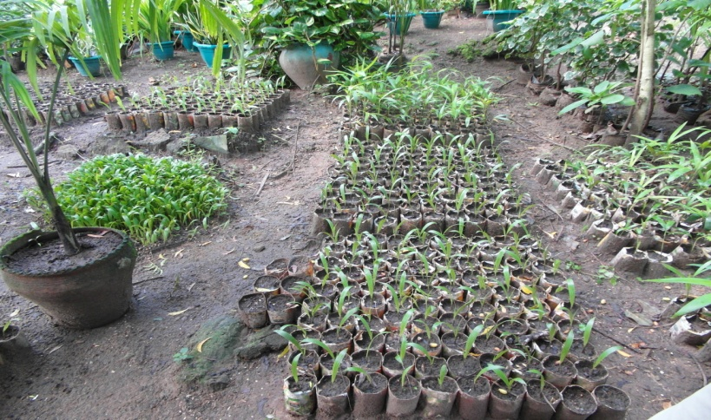
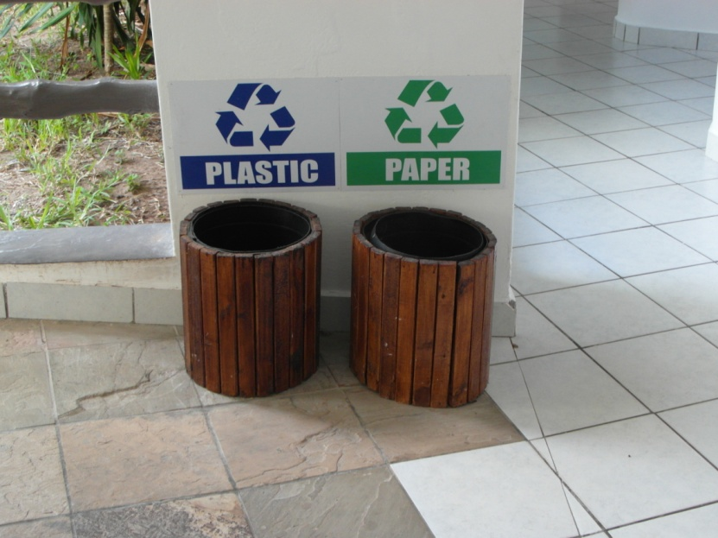
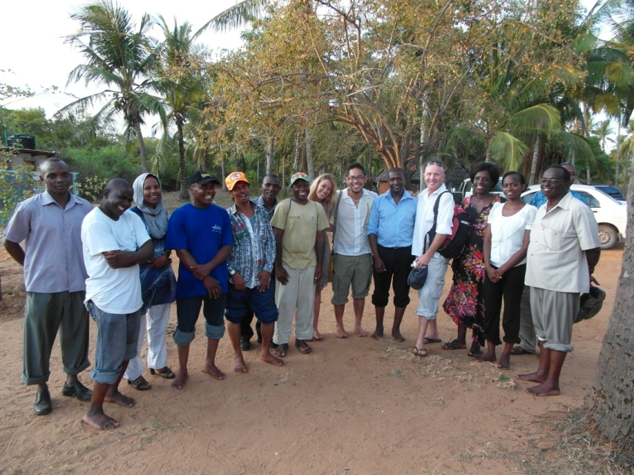
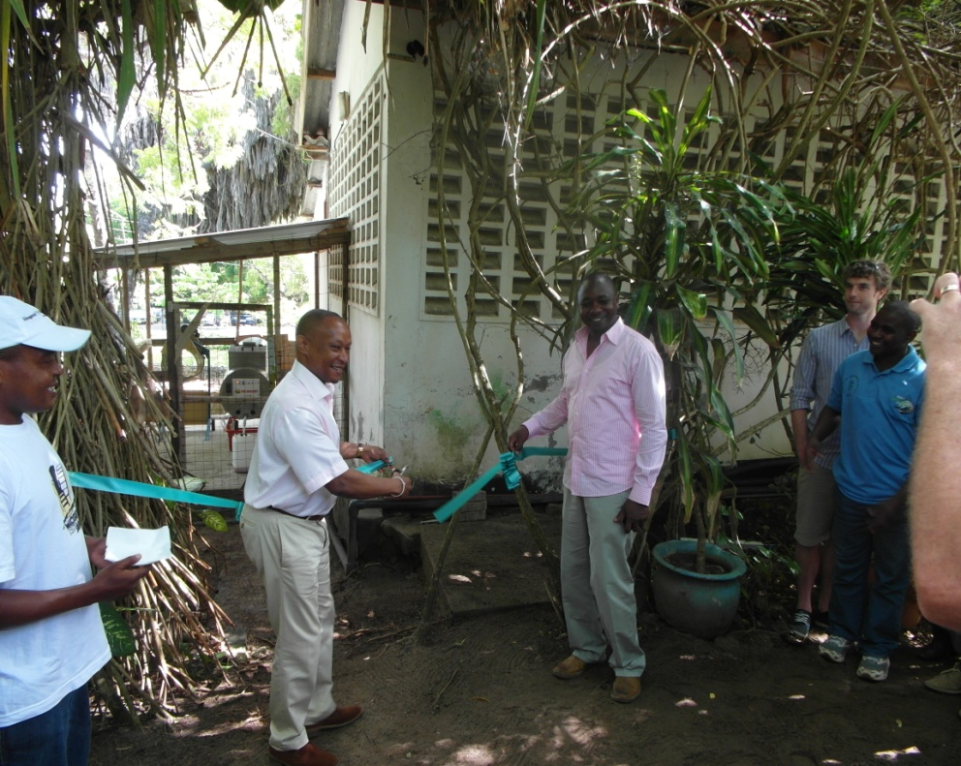
KENYA

Slide 11
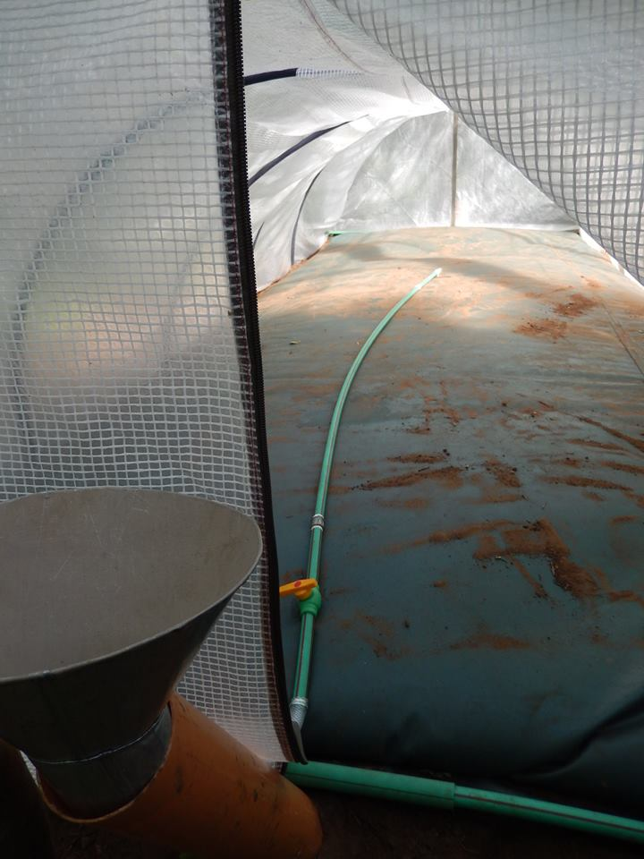
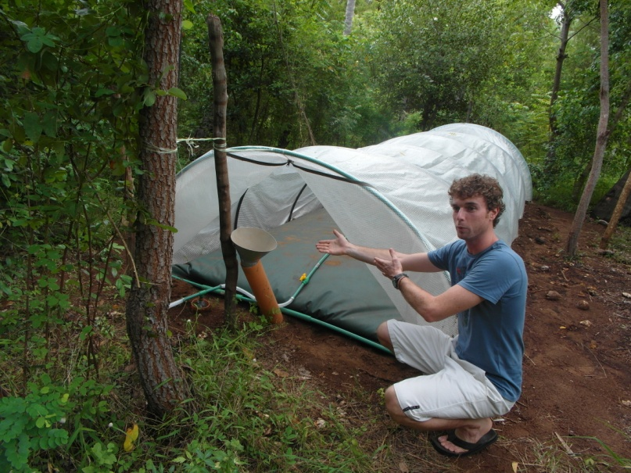
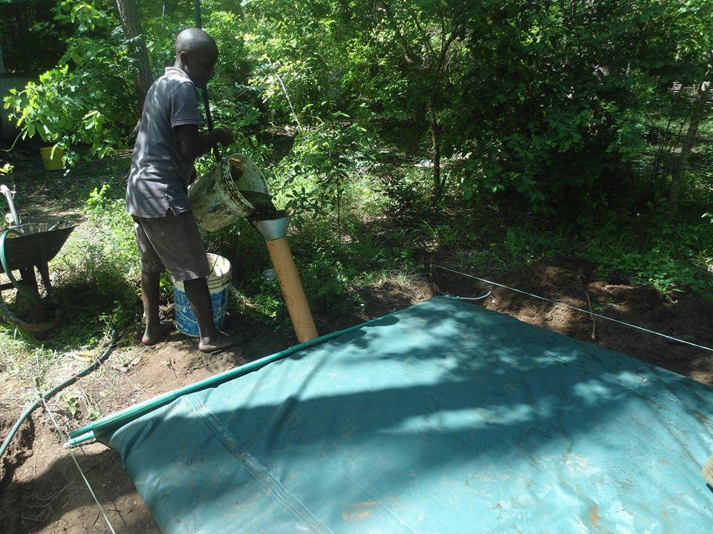
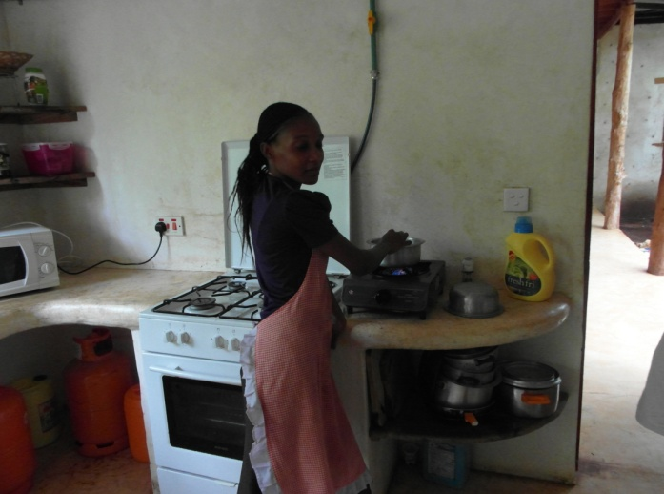
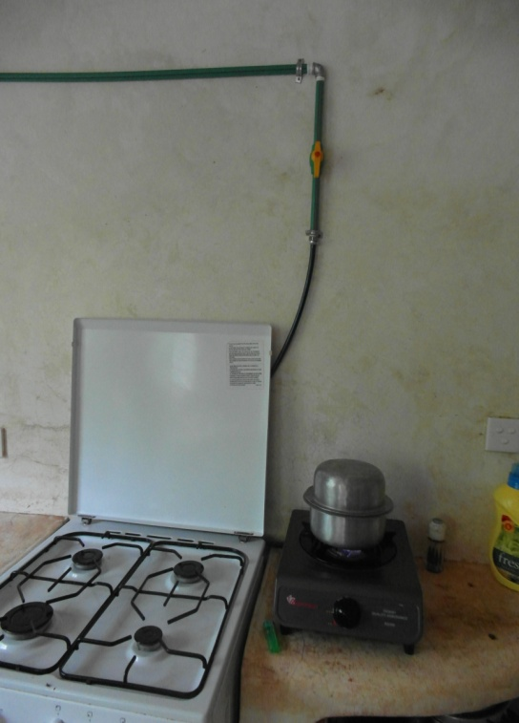
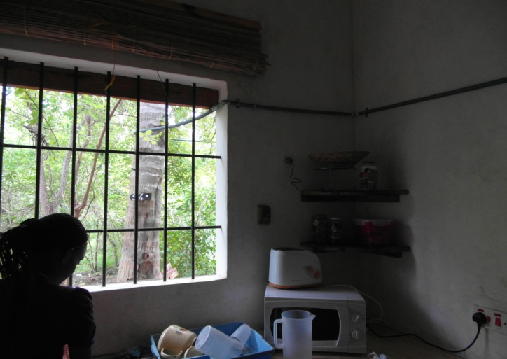
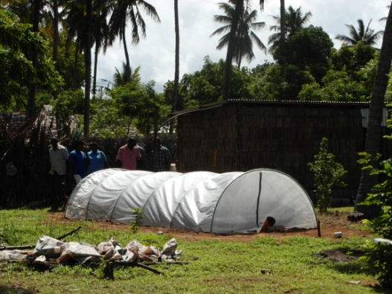
KENYA

Slide 12
KENYA: TEST IMPLEMENTATION PARTNERS
Partner | Type of institution
National Environmental Management Agency | Government
Ministry of Tourism | Government
Kenya National Cleaner Production Center | Trust
Hemingways Resort | Hotel
Turtle Bay Beach Club | Hotel
Local Ocean Trust | NGO
Watamu Marine Association | NGO
Hospitality Ltd./Tidy Planet (UK) | Private Sector/Supplier
Biogas Ltd. | Private Sector/Supplier
Kentainers | Private Sector/Supplier

Slide 13
Kenya: TEST Tool 1 (CPA), 3 (EMS) and 5 (CSR)
Figure 1. Overview of cost category of CP Recommendations in Kenya generated from the Kenya NCPC CPA work (No Cost=51, Low Cost=22, High Cost=9)
ECP= Environmental Conservation Program

Slide 14
Kenya: TEST Tool 1 (CPA), 3 (EMS) and 5 (CSR) - continued
Figure 2. Overview of the 82 CP Recommendations in Kenya

Slide 15
Kenya: Highlights
Establishment | Grouping/ CP Option | Cost type / Investment | Income / Savings | Pay Back Period | Environmental Benefits
Turtle Bay Beach Club | Energy: Energy Management including: De-lamping of excess lighting in the rooms | Low Cost: USD 427 | 29% reduction in energy use, 566,970 kWh annually | Immediate | Reduction in carbon emissions to the atmosphere
Hemingways Resort | EMS: Creation/ improvement of Energy policy; Water Management policy; Purchasing policy; Employee policy; Waste management policy | No Cost/ Management and staff time | Contribute to the over-all CP Recommendation implementation | Immediate | Relates to overall coordinated environmental benefits from energy, waste and water conservation

Slide 16
Kenya: TEST Tool 2 (EMA)
The sensitization of the top management level in the initial TEST/EMA trainings provided the initial ground work for the Kenya National Cleaner Production Center to be able to liaise with the hotels operational level
The EMA work identified cost centers in order to establish a baseline scenario across both participating hotels
These cost centers helped to prioritize the CPA work conducted by the KNCPC.

Slide 17
Kenya: TEST Tool 2 (EMA) - continued
Establishment | Management Level / Department Sensitized | Cost Center Identified
Turtle Bay Beach Club | General Manager Chief Finance Officer Environmental Officer/Community and Conservation Coordinator | Kitchen and restaurant Rooms Pool Laundry Water treatment plant Logistics (van for transporting guests) Common areas Garden Offices

Slide 18
Kenya: TEST Tool 4 (EST)
EST | Environmental Issue to be addressed | Partners | Role, Deliverables, Activity | COAST Project and Partner Expenditure
Rocket Composter (1 unit): | The EST will tackle issues on solid waste management especially with organic waste. The EST through CSR will provide surrounding communities with organic fertilizer and organic farming training. Thereby reducing synthetic fertilizer offloading to the coastal environment. | National Environmental Management Administration (NEMA) COAST project country contract funds); UNIDO/ COAST Project Office | Assist the procurement process; Provides funds and does the procurement; Purchase of the equipment | USD 26,725 and In Kind
 |  | Turtlebay Beach Club (TTBC) | Beneficiary of the EST; Training of the local farmers on the use of the compost (TBBC); Commencing the operation of the equipment; Maintenance | USD 3,436
 |  | Tidy planet (UK) via Hospitality Procurement Ltd. (Kenya) | Supplier; distributor and installation; Transportation from Port to Turtle Bay Beach Club Installation of the machine | Contribution to shipment

Slide 19
Kenya: TEST Tool 4 (EST) - continued
EST | Environmental Issue to be addressed | Partners | Role, Deliverables, Activity | COAST Project and Partner Expenditure
Flexi Biogas System (3 units): | The EST through a CSR model will demonstrate the use of organic waste in production of biogas to help economic and household activities, such as cooking. The use of alternative energy for cooking alleviates pressure on mangroves trees which are cut to produce charcoal that is then used as fuel for cooking purposes. | National Environmental Management Administration (NEMA COAST project country contract funds); UNIDO/ COAST Project Office | Assist the procurement process; Provides funds and does the procurement; Purchase of the equipment | USD 3,267 and In Kind
 |  | Hemmingways/Local Ocean Trust (LOT) /Watamu Marine Association (WMA) | Beneficiary of the EST; Showcases the Flexi Biogas System to their stakeholders as an alternative energy use; Training of community members in biogas harvesting | USD 1,500
 |  | Biogas Ltd (Kenya) | Supplier; distributor and installation | NA

Slide 20
Kenya: TEST Tool 4 (EST) - continued
EST | Environmental Issue to be addressed | Partners | Role, Deliverables, Activity | COAST Project and Partner Expenditure*
Waste Bins (85 units): | The EST through a CSR model will help alleviate land based pollution through solid waste management especially the process of waste segregation at point-source as a primary step in the recycling process. | National Environmental Management Administration (NEMA COAST project country contract funds); UNIDO/ COAST Project Office | Provides funds and assist in the procurement process | USD 3,150 and In kind
 |  | Watamu Marine Association (WMA) | Beneficiary of the EST; Maintenance; Provides training of local communities and hotel in waste segregation | USD 3,150
 |  | Kentainers, Mombasa, Kenya | Supplier, distributor and transport | NA

Slide 21
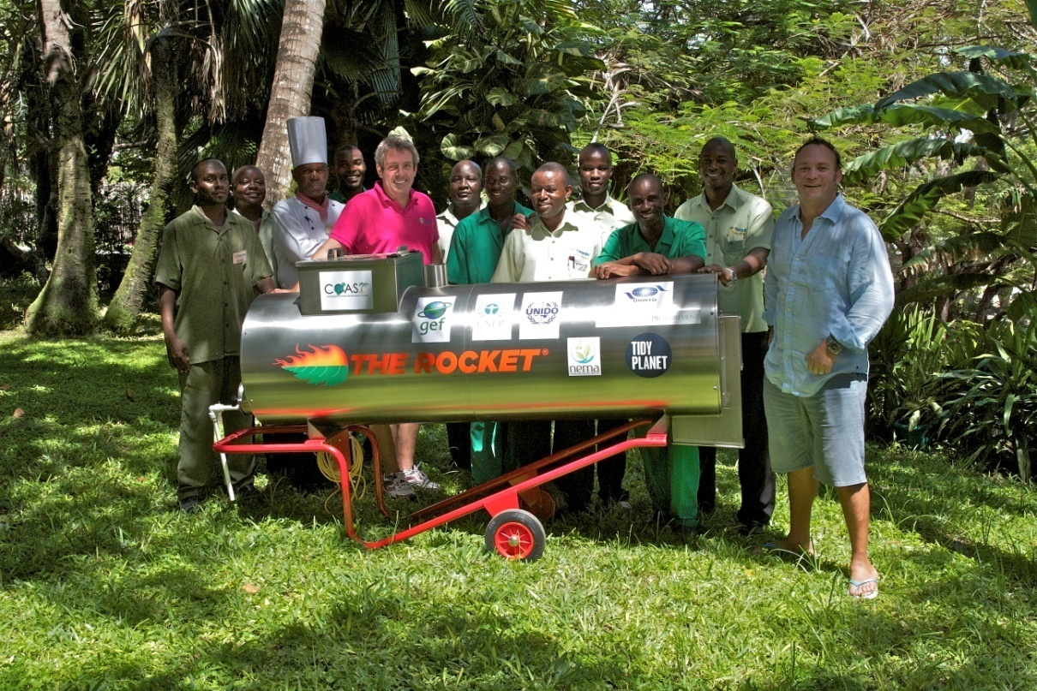
Kenya: TEST Tool 4 (EST)
Rocket Composter (1 unit)
USD 31,161
Speeds up the composting process through different shifts in mycofauna growth through a temperature and moisture controlled environment.
This EST is tied to a CSR activity involving the provision of compost and know-how for organic farming to the local communities.
In partnership with Turtle Bay Beach Club (145 Room Hotel)

Slide 22
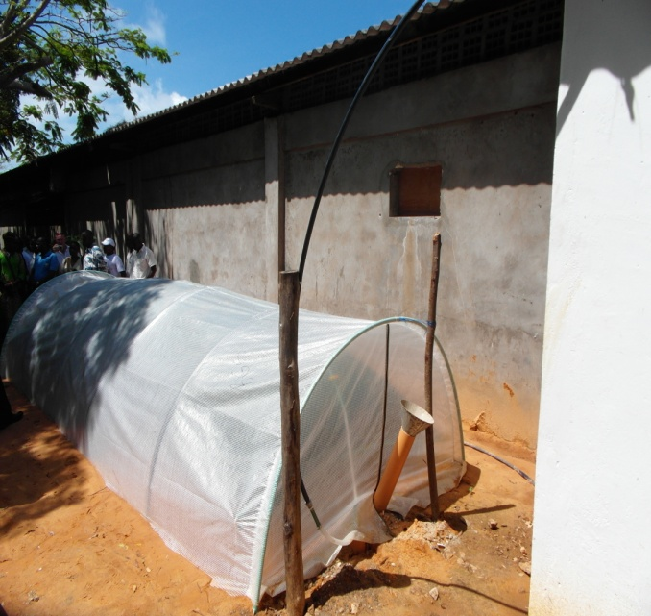
Kenya: TEST Tool 4 (EST) - continued
Flexi biogas system (3 units)
USD 4,767
Collects biogas from manure and other organic material to be used as an alternative to LPG, mainly for cooking.
This is tied to a CSR activity involving education and awareness programs and provision of compost and plants to local communities
. This EST is an identified Best Available Practice by FAO and IFAD.
In partnership with Hemingways Resort (76 Rooms) and 2 NGO Local Ocean Trust and Watamu Marine Association

Slide 23
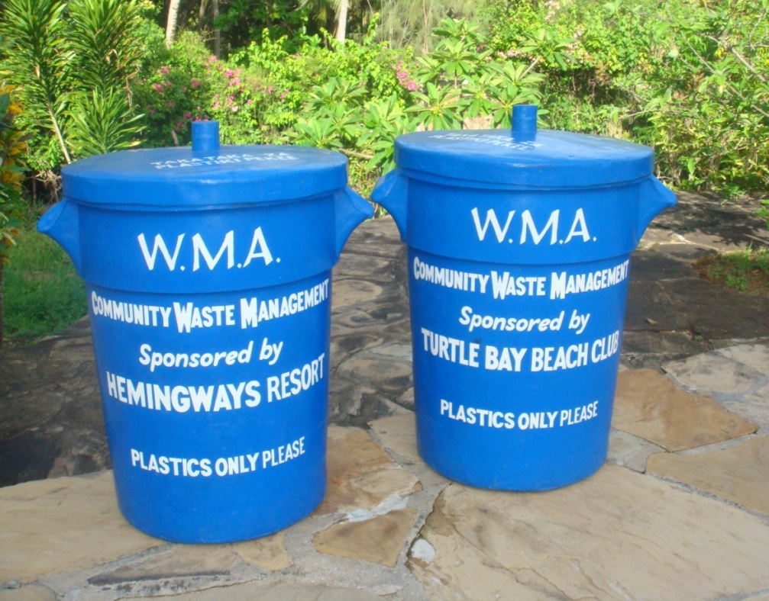
Kenya: TEST Tool 4 (EST) - continued
Waste Bins (85 units)
USD 3,450
Strategically placed in communities and hotels to serve as collection points of recyclable materials such as glass, paper and plastic.
This is tied to another COAST Project supported activity which is supporting a recycling facility initiated by WMA though the Ecotourism Theme and Annual Plan activities.
In partnership with Watamu Marine Association

Slide 24
Kenya: Highlights
Hemingways Resort: 34% reduction in Electricity bill within a 2 month period
Turtle Bay Beach Club: 29% decrease in Energy Use and 20% decrease in materials use
Demonstration sites in Hemingways, Local Ocean Trust and Watamu Marine Association produce alternative energy to decrease mangrove extraction for fuel, using best available technology such as Rocket Composter and Flexi biogas system

Slide 25
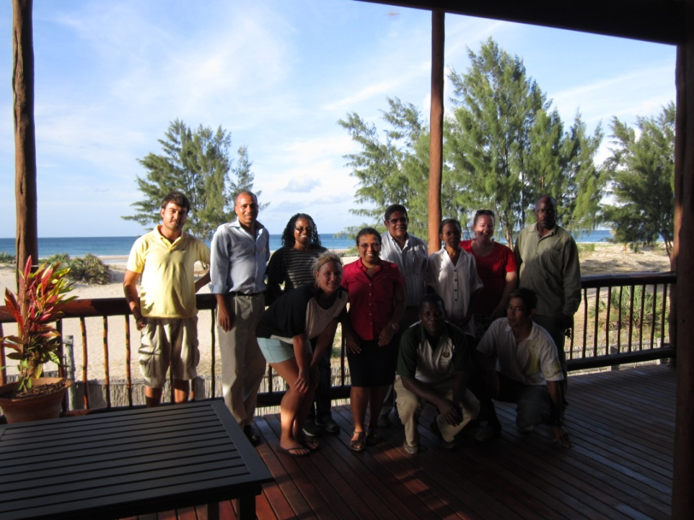
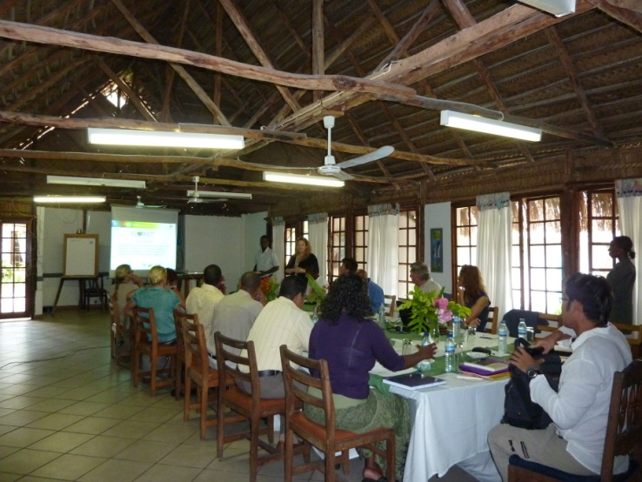
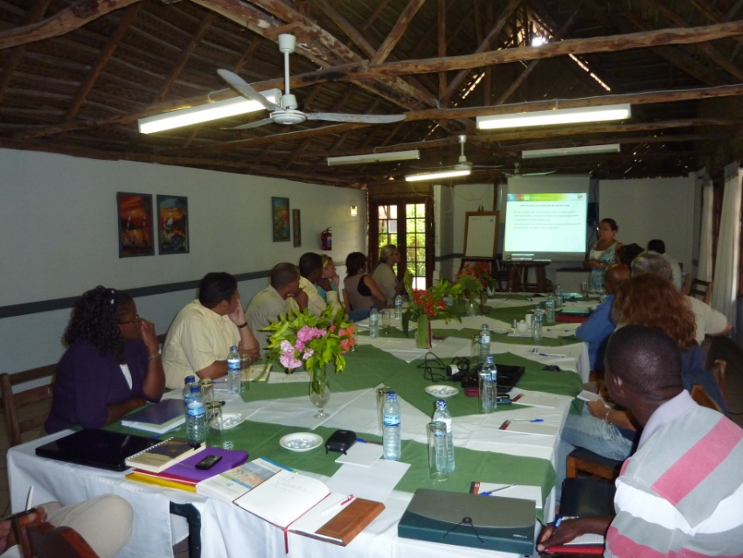
MOZAMBIQUE TEST Implementation

Slide 26
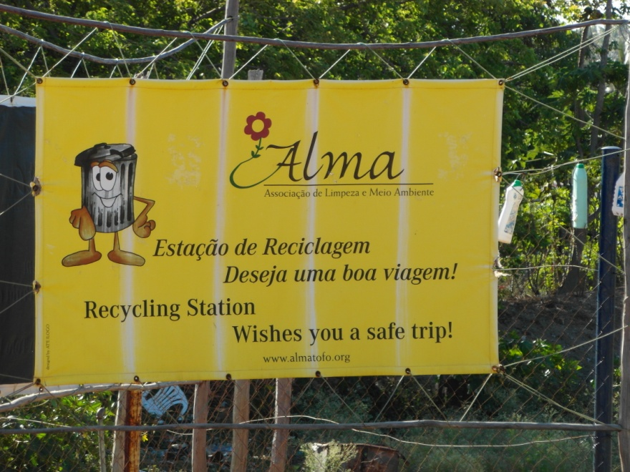
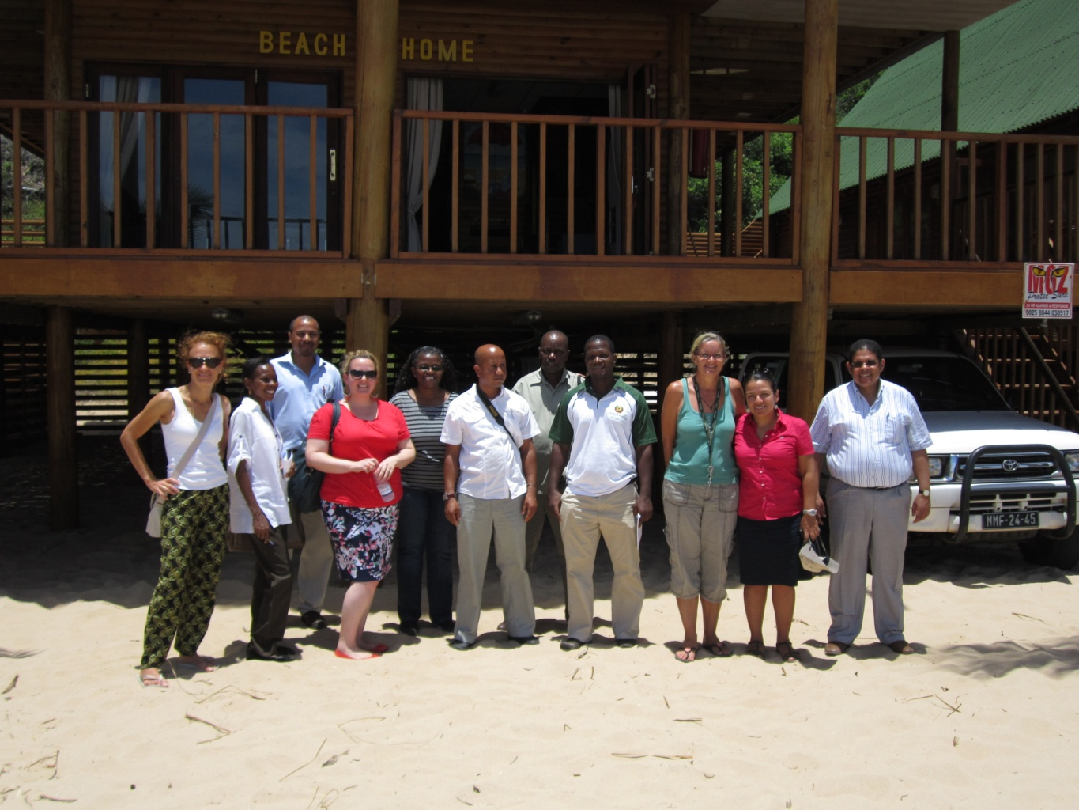
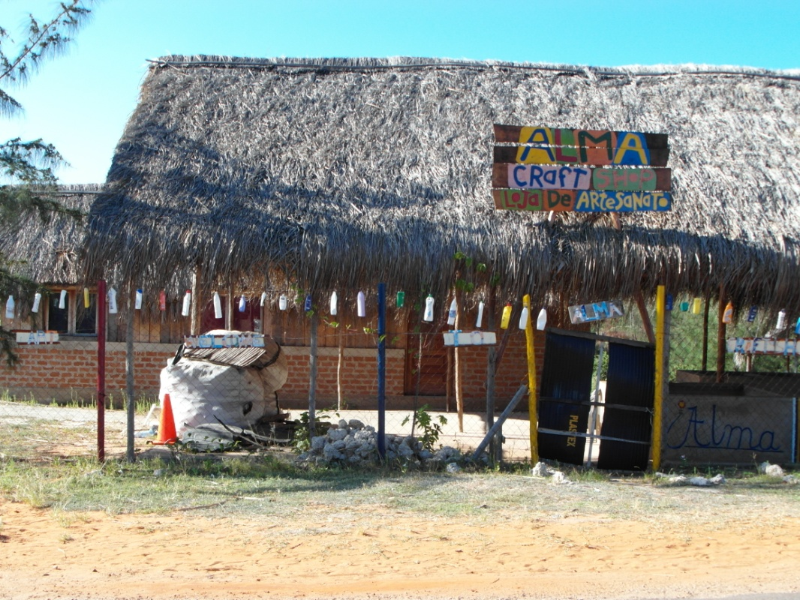
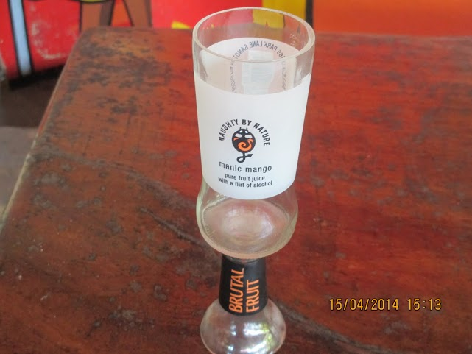
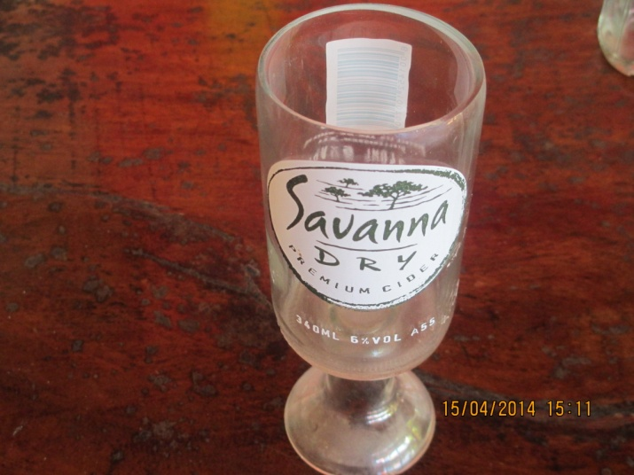
MOZAMBIQUE

Slide 27
Partners
Partner | Type of institution
Ministry for the Coordination of Environmental Affairs | Government
Ministry of Tourism | Government
Mozambique National Cleaner Production Center | Trust
Bay View Lodge | Hotel
Farol do Barra | Hotel
Vista Do Mar | Hotel
Dino’s Bar | Restaurant

Slide 28
Mozambique: TEST Tool 1 (CPA), 3 (EMS) and 5 (CSR)
Figure 3. Overview of cost category of CP Recommendations in Mozambique (No Cost=62, Low Cost=16, High Cost=4)

Slide 29
Mozambique : TEST Tool 1 (CPA), 3 (EMS) and 5 (CSR)- continued
Figure 4. Overview of the 82 CP Recommendations in Mozambique

Slide 30
MOZAMBIQUE: Highlights
Establishment | Grouping/ CP Option | Cost type / Investment* | Estimated Income / Savings | Pay Back Period | Environmental Benefits
Bay View Lodge | Water: Laundry / Kitchen area CP recommendations including: Implement a linen reuse programme based on voluntary guest adherence | High Cost: USD 750 | USD 3,000 | 3 months | Reduces pollution by reducing the amount of soap used daily; water resource conservation; energy conservation from washing machines and saves water that is used unnecessarily in doing laundry on a daily basis
Dino’s Bar | Energy: Kitchen recommendations including: Avoid connecting the electric equipment when not in use | Low Cost: USD 100 | Variable | Variable | Reduction in carbon emissions to the atmosphere

Slide 31
Mozambique: TEST Tool 2 (EMA)
The sensitization of the top management level in the initial TEST/EMA trainings provided the initial ground work for the Kenya National Cleaner Production Center to be able to liaise with the hotels operational level
The EMA work identified cost centers in order to establish a baseline scenario across both participating hotels
These cost centers helped to prioritize the CPA work conducted by the MNCPC.

Slide 32
Mozambique: TEST Tool 2 (EMA) - continued
Establishment | Management Level / Department Sensitized | Cost Center Identified
Vista do Mar | General Manager | Rooms Laundry Aquatic equipment Kitchen Dinner and bar area Pool

Slide 33
Mozambique: TEST Tool 4 (EST)
EST | Environmental Issue to be addressed | Partners | Role, Deliverables/Activity | COAST Project and Partner Expenditure
Artisanal glass cutting | Decreasing land based pollution, particularly glass bottle waste generated by the tourism industry | Provincial Directorate for the Coordination of Environmental Activities Inhambane (DPCA-I)/ COAST Project (COAST project country contract funds) | Overall supervision and monitoring of the project/ Key donor and support provided via the VSO volunteer on site | USD 5,215 and In Kind
 |  | Dino’s Bar/Ms. Natalie Nordine | Supervision and Supply and collection of waste glass; provision of suitable land site for project, water and electricity and labour for construction; contribution towards purchase of local material for construction; technical know-how on the artisanal glass cutting; project planner and trainer; revolving fund administration | USD 9,000 and In Kind

Slide 34
Mozambique: TEST Tool 4 (EST) - continued
 |  | Partners | Role, Deliverables/Activity | COAST Project and Partner Expenditure
 |  | Provincial Directorate for Tourism Inhambane (DPTUR-I) | Support in lobbying and advocacy work amongst other Government sectors (i.e. health department) and support in accessing suitable markets | In-kind
 |  | Municipal Council of Inhambane City (CMCI) | Support in education and awareness raising on the need of garbage separation from the source. | In- Kind
 |  | Community members | Receive training on a volunteer basis, supply of waste glass in the future, and replicating the activity | In- Kind
 |  | Private sector partners and Tourism and Hotel Association (ASHT-I) | Support in the identification of markets and possible replication of the activity | In- Kind
 |  | Provincial Directorate of Health (DPS) | Quality control/inspection of the produced glass to ensure its safety | In- Kind

Slide 35
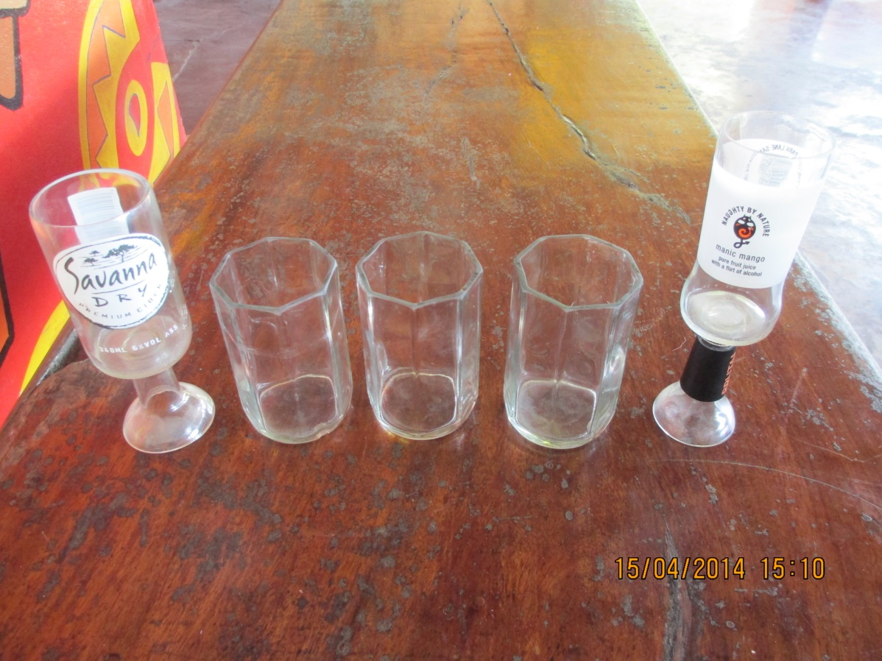
Mozambique: TEST Tool 4 (EST)
Artisanal glass cutting
USD 14,215
The activity involves provision of glass cutting equipment, capacity building in the skill of artisanal glass cutting, provision of work space and access to markets to sell the outputs/products.
Capacity, skills and trade building for local communities
In partnership with Dino’s Bar

Slide 36
Mozambique: Highlights
Bay View Lodge: Improved resource efficiency in kitchen and laundry area use
Dino’s Bar: Additional livelihood activities for local people through recycling of the waste from the hotels

Slide 37
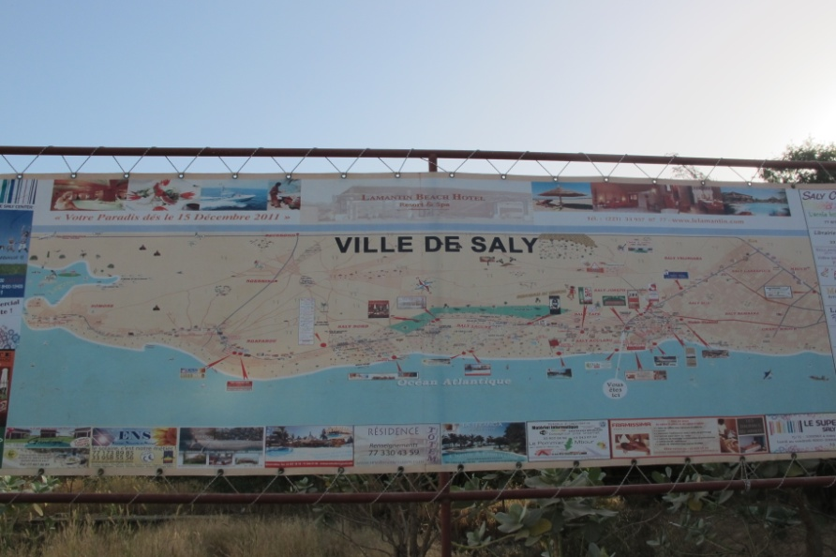
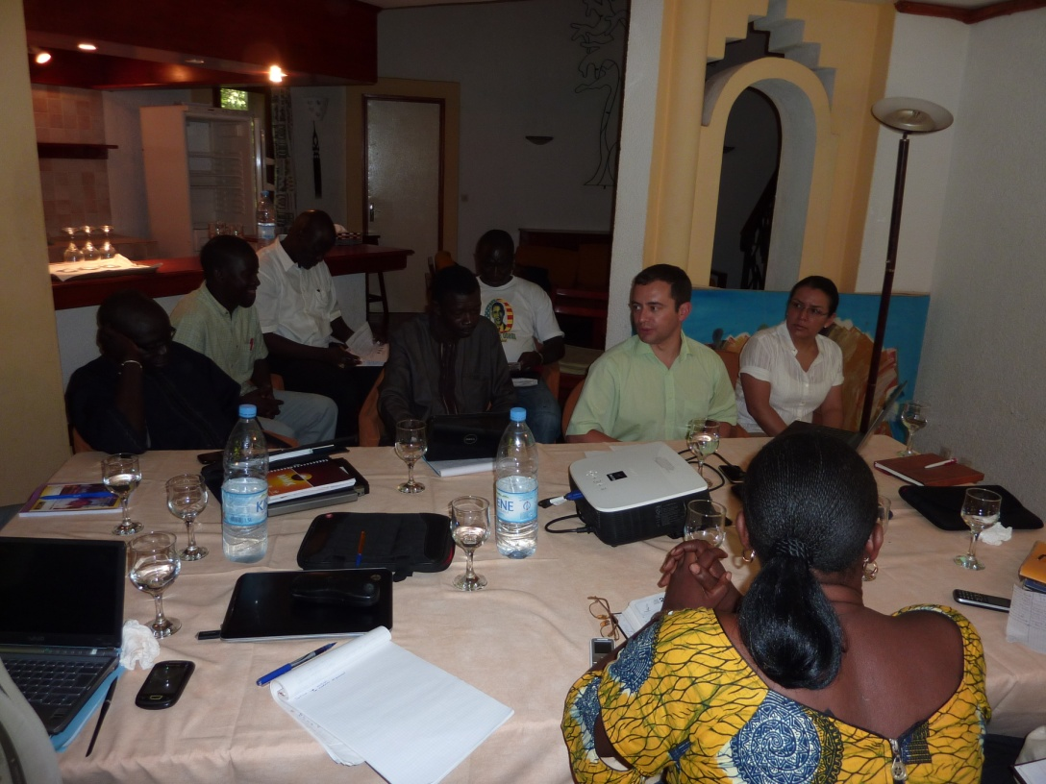
SENEGAL TEST Implementation

Slide 38
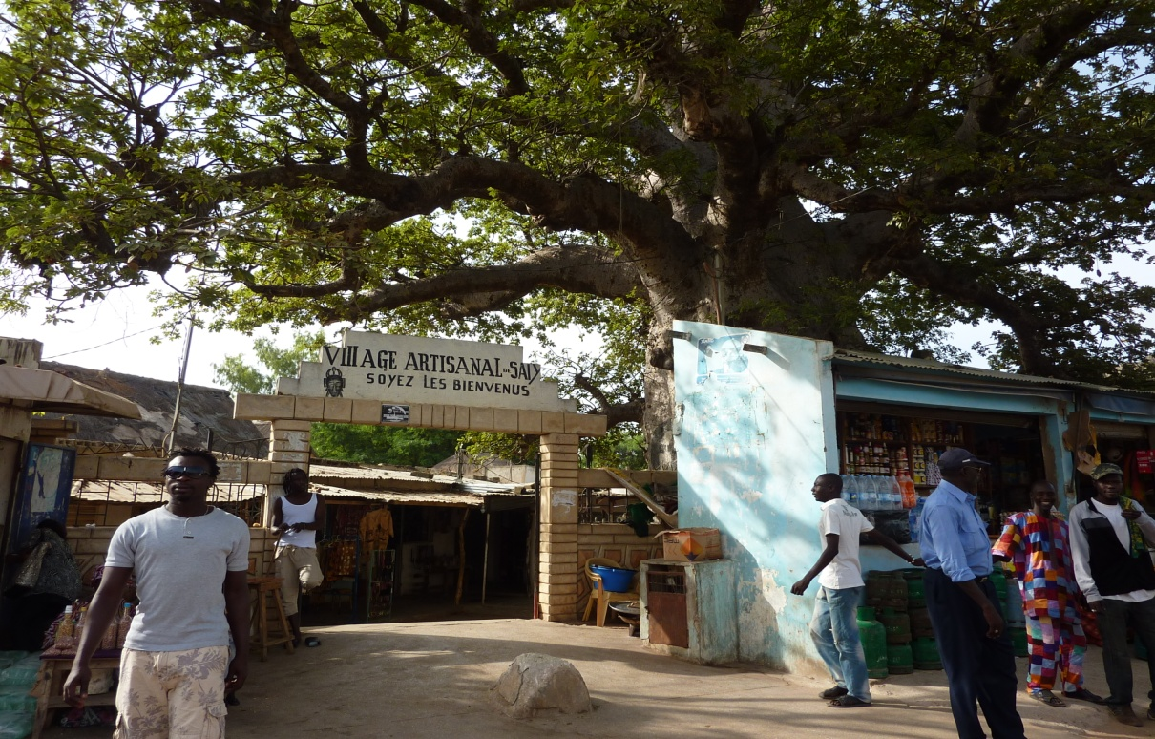
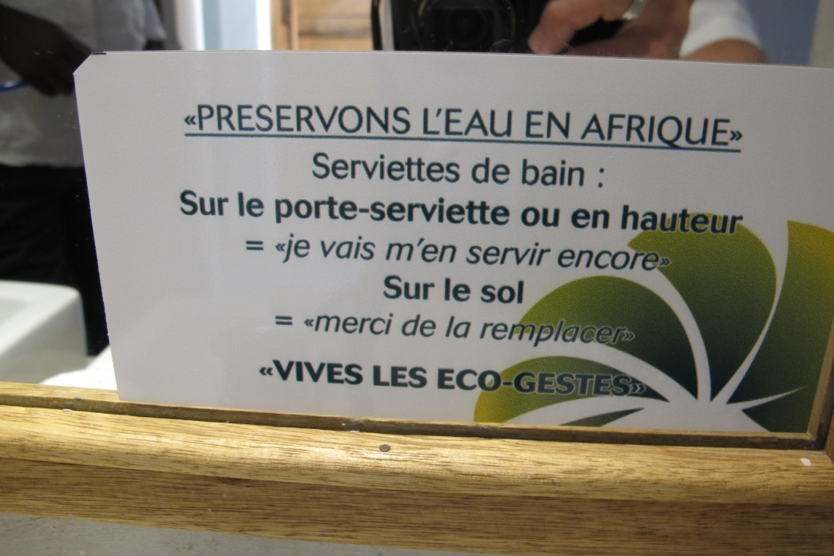
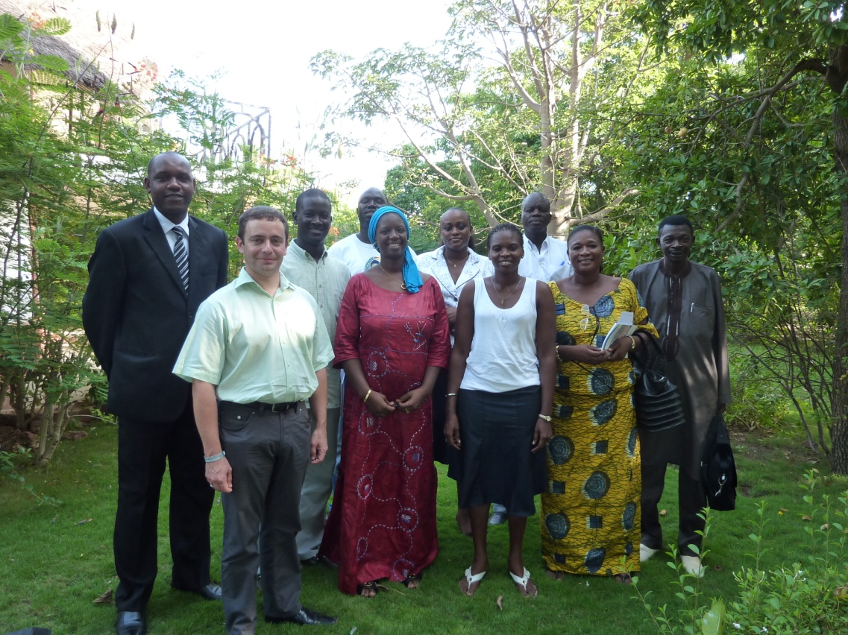
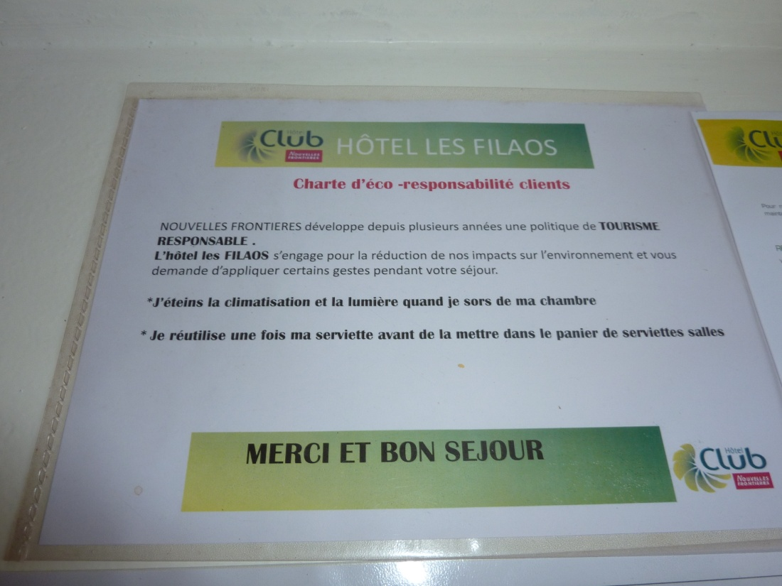
SENEGAL

Slide 39
Partners
Partner | Type of institution
Ministère de l’Environnement et du Développement Durable | Government
Ministère du Tourisme et des Transports Aériens | Government
National EMS experts
SAPCO - Société d’Aménagement et de Promotion des Côtes et Zones Touristiques du Sénégal | Parastatal
Framissima Palm Beach Hotel | Hotel
Lamantin Beach Hotel Resort & Spa | Hotel
La Teranga Hotel | Hotel
Hotel les Bougainvillées | Hotel
Club Marmara Saly Les Filaos | Hotel
Notes:
Verify Ministry names for Environment and Tourism

Slide 40
Senegal: TEST Tool 1 (CPA), 3 (EMS) and 5 (CSR)
Figure 5. Overview of cost category of 562 CP Recommendations in Senegal

Slide 41
SENEGAL: Highlights
Establishment | Grouping/ CP Option | Cost type / Investment | Estimated Income / Savings | Pay Back Period | Environmental Benefits
Framissima Palm Beach Hotel | Energy: Installation of 5000 litre solar water heater | USD 40,568 | USD 4,952 | 8 years | 325,057 kg CO2 reduction per year
Lamantin Beach Hotel Resort & Spa | Energy: Installation of 141 solar water heaters (85 litre) | USD 143,002 | USD 20,224 | 7 years | 221,267 kg CO2 reduction per year
La Teranga Hotel | Energy: Installation of 100 solar street lights (50 high and 50 low) | USD 73,022 | USD 23,465 | 3 years | Between 48,400- 53,800 kg of CO2 reduction per year
Hotel les Bougainvillées | Energy: Installation of 86 solar water heaters (85 litre) | USD 87,221 | USD 15,786 | 5.5 years | 181,837 kg of CO2 reduction per year
Club Marmara Saly Les Filaos | Energy: Installation of 120 solar water heaters (85 litre) | USD 121,704 | USD 16,620 | 8 years | 172,712 kg of CO2 reduction per year

Slide 42
Senegal: TEST Tool 2 (EMA)
The sensitization of the top management level in the initial TEST/EMA trainings provided the initial ground work for the Kenya National Cleaner Production Center to be able to liaise with the hotels operational level
The EMA work identified cost centers in order to establish a baseline scenario across both participating hotels
These cost centers helped to prioritize the CPA work conducted by the national EMS experts.

Slide 43
Senegal: TEST Tool 2 (EMA) - continued
Establishment | Management Level / Department Sensitized | Cost Center Identified
Framissima Palm Beach Hotel | Head of Accounting Environmental Manager Head of Technical Services | Rooms Kitchen and restaurant Laundry Pool Garden Common areas Office area

Slide 44
Senegal: TEST Tool 4 (EST)
EST | Environmental Issue to be addressed | Partners | Role, Deliverables, Activity | COAST Project and Partner Expenditure
Composting Station (1 unit): | The EST through a CSR model will tackle issues on solid waste management especially with organic waste. | Société d'Aménagement et de Promotion de la Petite Côte (SAPCO) | Provides technology training, ensures access to land, assumes maintenance of the EST and supports waste collection from the partner hotels. | USD 1,500 (training) and In Kind
 |  | UNIDO/COAST Project (COAST project country contract funds); | Provides funds for the equipment | USD 11,366
 |  | AGROSEN (Senegal) | Supplier; distributor and Installation of the plate-form
 |  | Saly City Hall | Institutional support to women groups; support maintenance of the technology; up scaling | In kind
 |  | Hotels (Framissima Palm Beach Hotel, Lamantin Beach Hotel Resort & Spa, La Teranga Hotel, Hotel les Bougainvillées, Club Marmara Saly Les Filaos) | Potential customers; Member of the Management Committee of the EST | In Kind
 |  | Women’s groups | Management and seller of the compost | In Kind

Slide 45
Senegal: Highlights
Increased CSR activities in the hotel sector
Energy audit provided to the hotel partners to increase energy efficiency
Projected annual reduction of 949 tonnes of carbon emissions to the atmosphere by using solar energy
Projected production of 10 tonnes of compost per month using organic waste produced by hotels (up to 46 tonnes per day)

Slide 46
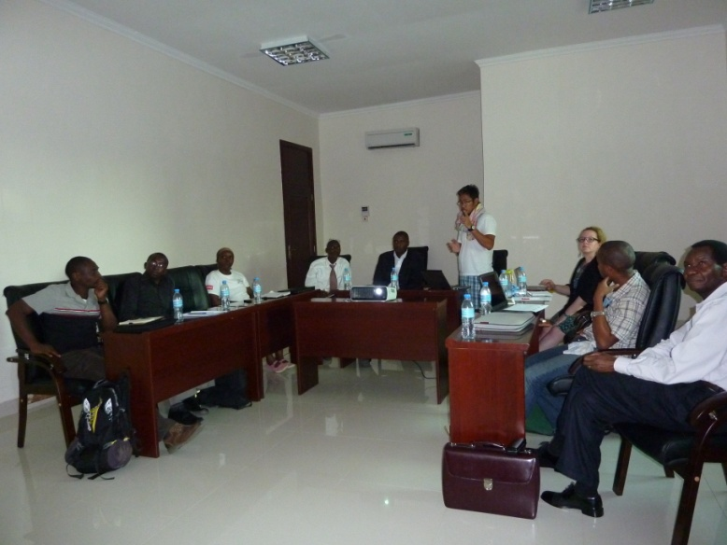
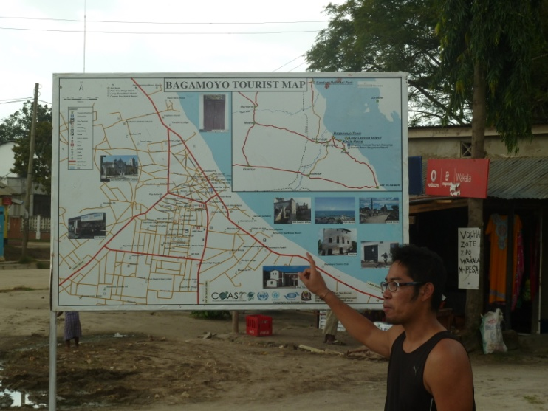
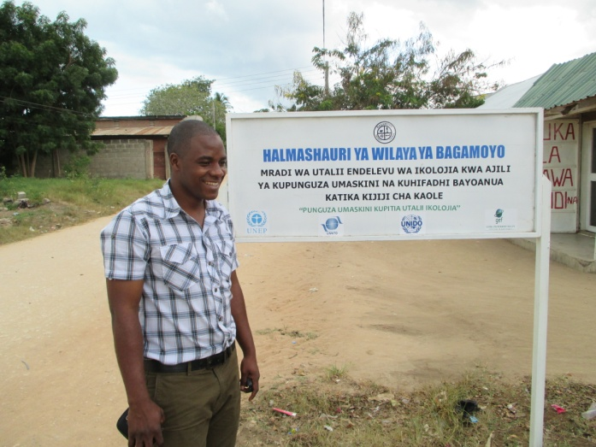
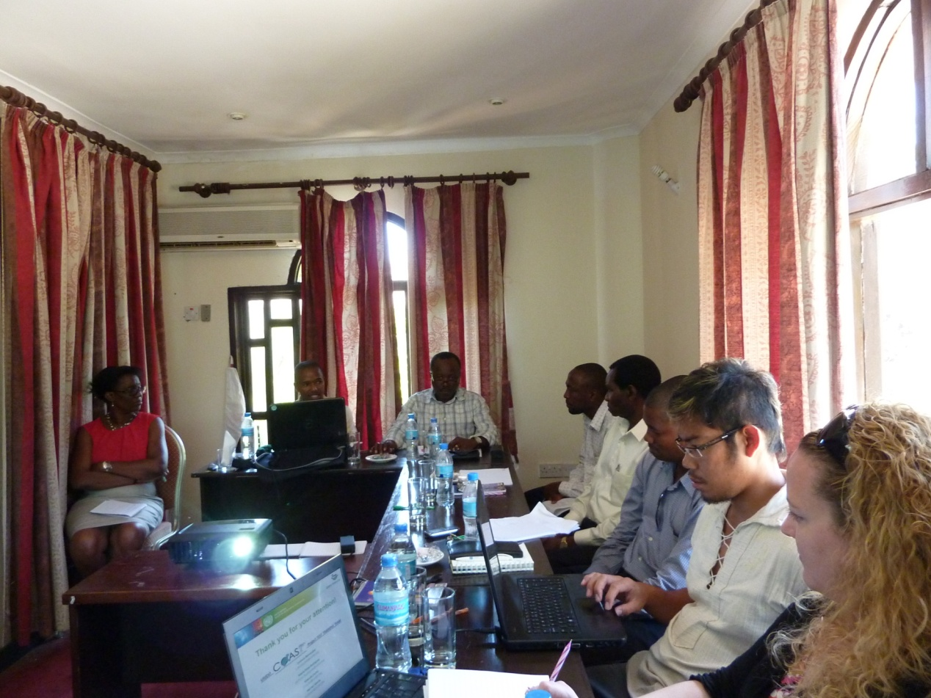
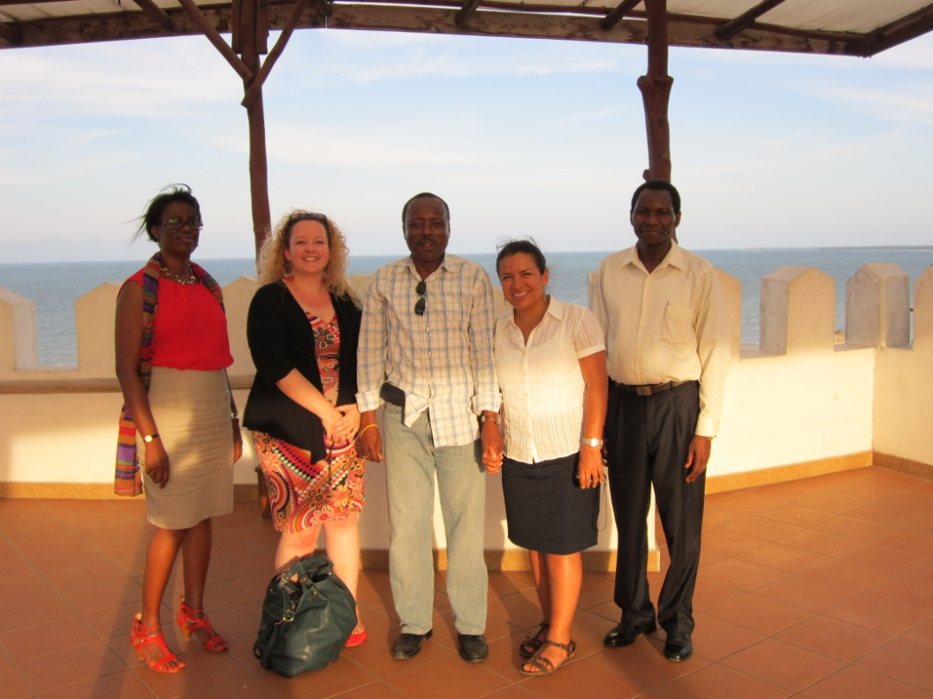
TANZANIA TEST Implementation

Slide 47
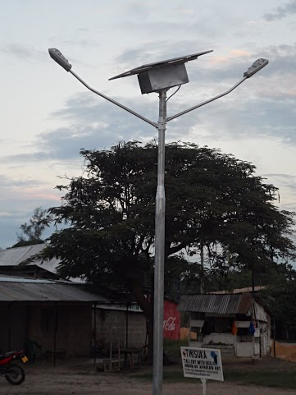
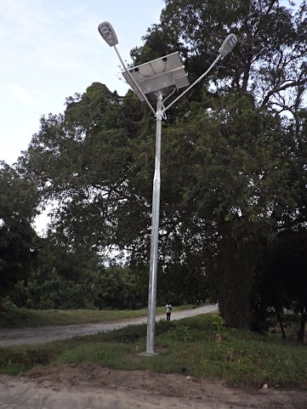
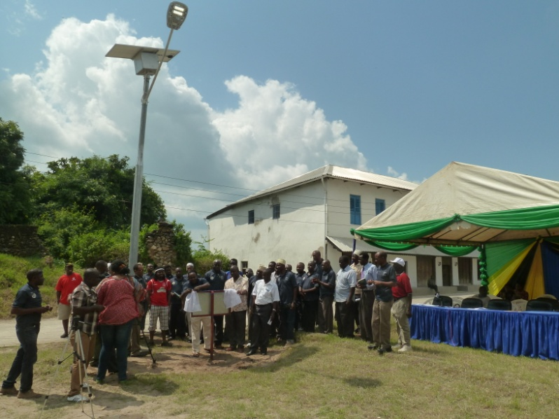
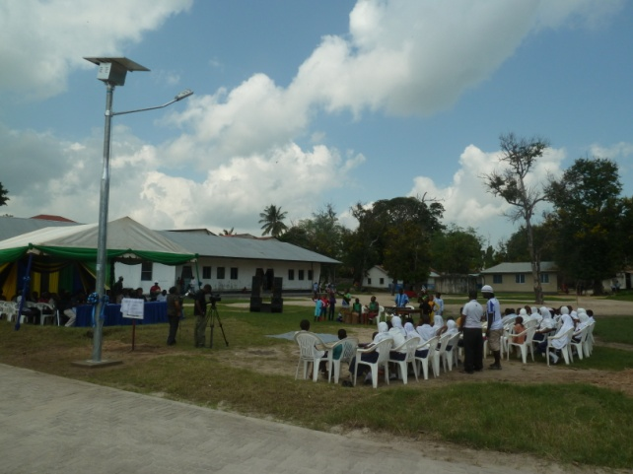
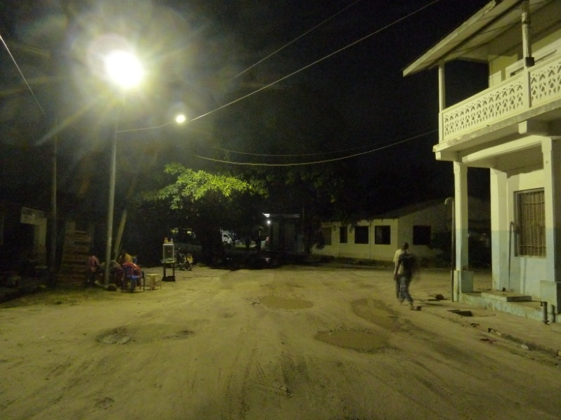
TANZANIA

Slide 48
Partners
Partner | Type of institution
Tanzania Vice Presidents Office | Government
Ministry of Natural Resources and Tourism | Government
Cleaner Production Center-Tanzania | Trust
Bagamoyo District Council | Government
Bomani Beach Bungalows | Hotel
Millennium Hotels | Hotel
Oceanic Hotel | Hotel
Ensol Ltd. | Private Sector/Supplier

Slide 49
Tanzania: TEST Tool 1 (CPA), 3 (EMS) and 5 (CSR)
Figure 6. Overview of cost category of CP Recommendations in Tanzania (No Cost=57, Low Cost=41, High Cost=10)
OHS = Occupational Health and Safety

Slide 50
Tanzania: TEST Tool 1 (CPA), 3 (EMS) and 5 (CSR) - continued
Figure 23. Overview of CP 108 Recommendations in Tanzania

Slide 51
TANZANIA: Highlights
Establishment | Grouping/ CP Option | Cost type / Investment | Estimated Income / Savings* | Pay Back Period | Environmental Benefits
Millennium Old Post Office | Energy: Develop and implement energy management strategies to monitor and minimize energy consumption and assign staff to implement energy saving programme/plan | No Cost: Management and staff time | USD 3,140 | Subject to the CP recommendation adopted | Reduction of CO² emissions by 1.5 tonnes
Millennium Sea Breeze | Energy: Replace the fluorescent tube lights (19) with energy saver lights | USD 53 | USD 82 | 7.8 months | Reduction of CO² emissions
 | Water: Water Management including: Formulate water management policy, assign staff to implement water saving programme/plan, Sensitize staff and guests on proper use of water | USD 179 | USD 826 | 1.8 months minimum | Water resource conservation
Oceanic Bay Hotel and Resort | Water: Water Management including: Assigning staff to implement water saving programme/plan | USD 521 | 10-20% reduction | Immediate | Reduces resource strain to water sources

Slide 52
Tanzania: TEST Tool 2 (EMA)
The sensitization of the top management level in the initial TEST/EMA trainings provided the initial ground work for the Tanzania National Cleaner Production Center to be able to liaise with the hotels operational level
The EMA work identified cost centers in order to establish a baseline scenario across both participating hotels
These cost centers helped to prioritize the CPA work conducted by the national CPC-Tanzania.

Slide 53
Tanzania: TEST Tool 2 (EMA) - continued
Establishment | Management Level / Department Sensitized | Cost Center Identified
Oceanic Bay Hotel and Result | Operations Manager Residential Manager Financial Manager | Rooms Laundry Kitchen and restaurant Conference area Pool Garden Common areas Office area

Slide 54
Tanzania: TEST Tool 4 (EST)
EST | Environmental Issue to be addressed | Partners | Role, Deliverables/Activity | COAST Project and Partner Expenditure*
Solar lighting (20 units): | Improve the livelihood and security in the main tourist area of Bagamoyo with use of renewable energy. Linked with Eco-Tourism Theme activity (i.e. arts/crafts and food sellers training). | Tanzania VPO Office (COAST project country contract funds); UNIDO/ COAST Project | Provides funds; assistance in the procurement process | USD 53,020.96
 |  | The District Executive Director and Bagamoyo District Council | MOU with the Supplier and assistance in procurement process; Beneficiary of the EST; Conducts community organizing to identify areas of installation; maintenance of the street lamps up to 5 years after installation; Institutionalization of a community watch group with private stakeholder to monitor the street lamps through an MOU. | In Kind
 |  | TEMESA | Monitoring activities to ensure equipment meets government standards | In Kind
 |  | Ensol Ltd. | Supplier, Conducts consultation and night survey for identification of installation site; Installation and maintenance; Responsible for maintenance of the street lamps up to 2 years after installation | In Kind

Slide 55
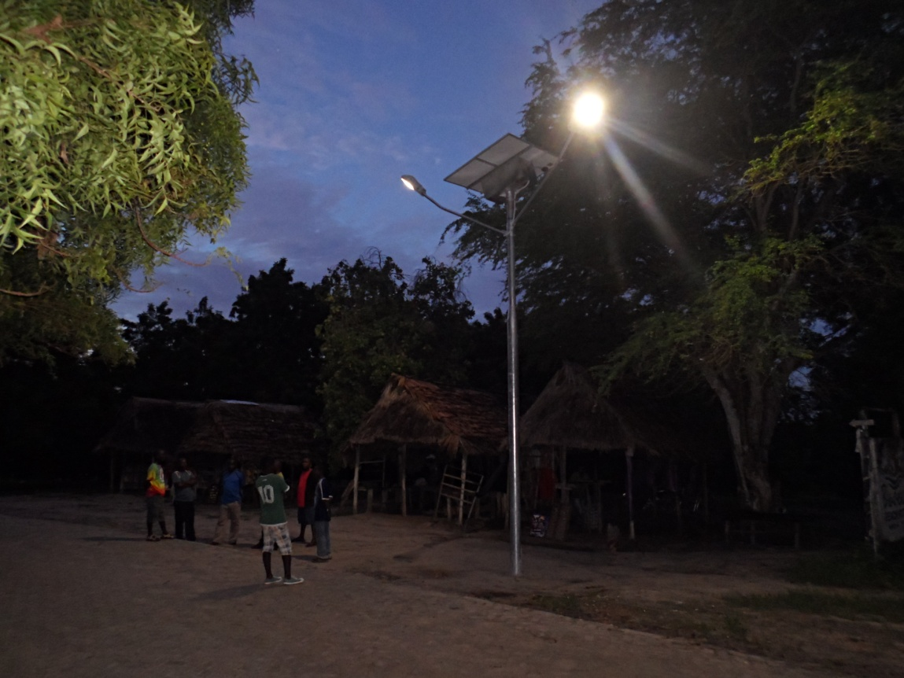
Tanzania: TEST Tool 4 (EST)
Solar lighting (20 units)
USD 53,020.96
LED solar street technology.
Linked to livelihood diversification of the COAST Eco-tourism Theme
Increases security for tourism and local and livelihood opportunities.
In partnership with Bagamoyo District Council and the hotel sector

Slide 56
Tanzania: Highlights
Oceanic Hotel and Bomani Beach Bungalows: Environmental Policy put into place
Millennium Hotels: Waste management system improved and staff sensitized on efficient resource use
Increased security in the lighted area by the Solar Street Lamps, that also allow for economic/income generating activities, and recreational activities to go on for longer

Slide 57
Summary on BENEFITs to implementing TEST in the Hotel Industry
Land based pollution reduction through efficient resource use and reduction of waste production (i.e. recycling of solid waste, reduction of packaging materials, and shift to renewable energy)
Enhanced aesthetics and cleanliness leads to increased tourist visits to hotels
Safety at night for local population and tourists (i.e. solar lighting)
Contribution to sustainable coastal livelihoods through enhanced capacity building measures; new income generation and employment options through TEST implementation, i.e. staff to operate the rocket composter and solid waste bio-digesters (Watamu); longer opening hours for art and food sellers with solar street lamps (Bagamoyo); glass cutting activity (Inhambane)

Slide 58
Summary on BENEFITs to implementing TEST in the Hotel Industry - continued
Tool to assist managers to be more strategic in planning and operations
Improvement in Staff Morale
Improvement in the image of the Hotel and its competitiveness
Financial Savings through:
Reduced operational costs
Reduced materials and energy costs
Improved resource inefficiency
EST initiatives and recycled products
Keep ahead of impending legislations and other regulations.

Slide 59
Lessons & Recommendations
Acknowledgment that the provision of an environmental service industry is a profitable source for ample business opportunities
Contribution to sustainable coastal livelihoods through the enhanced capacity building measures and the new income generation and employment options that became available through the implementation of the TEST methodology
CSR attracts green consumerism, and opens up a new market for the hotels in terms of responsible and conscious tourism.
Economic opportunities through reduced operational costs; through decreased materials and energy costs; through savings in resource inefficiencies; through sales of waste materials, outputs of EST initiatives and recycled products.
Land based pollution reduction occurs through efficient resource use and reduction of waste from tourism industry (i.e. recycling of solid waste, reduction of packaging materials, and shift to renewable energy).

Slide 60
Lessons & Recommendations - continued
Hotels have realized the gaps in their information/accounting systems, and intend to record further data from now on as they have now clearly seen the economic benefits of having such data
Provision of strategic science and technology frameworks that encourage green innovation and the transfer, development and adaptation of environmentally sound best practices and technologies (i.e. Global South-South Cooperation; East African Climate Change Innovation Network)
Strengthened partnerships and dialogue platforms amongst the Demo Site stakeholders (Government, local communities, and private sector) are in place that can yield replication and up scaling of current activities, as well as new business opportunities, investments and cooperation models in the future
Governments to provide a more favorable investment climate for the private sector to be able to invest into green technologies and pollution control infrastructure by creation of support institutions, accreditation and certification bodies; and tax levies on environmentally sound technology equipment

Slide 61
UNIDO TEST TEAM
Mr. Ludovic Bernaudat
L.Bernaudat@unido.org
Ms. Marla McCarroll Pinto Rodrigues
M.Pinto-Rodrigues@unido.org
Mr. Harvey Garcia
H.Garcia@unido.org
Ms. Yolanda Cachu (EMA expert)
Y.Cachu@unido.org
Special Support from VSO Esther Munyithia in Inhambane, Mozambique.
Photo credits: COAST project; Country Partners; Watamu Marine Association; Local Ocean Trust: Watamu Turtle Watch.

Slide 62
A big thank you to the National Cleaner Production Center Implementation Partners:
Kenya:
Jane Nyakang’o (Director)
Kenya National Cleaner Production Center
P.O. Box 1360– 00200, Popo Road, Off Mombasa Rd, Nairobi - Kenya
Tel/Fax +254-2-6004870/ 1 +254 734 412 402
E-mail: info@cpkenya.org; Website: www.cpkenya.org
Mozambique:
João Carlos Frade (Director)
Mozambique National Cleaner Production Centre
Avenida Romão Fernandes Farinha, 154 Edifício do FEMA , Maputo – Mozambique
Tel: +258 82 3235040
Email: mncpc@tvcabo.co.mz; Website: www.mncpc.co.mz
Tanzania:
Prof. Cleophas Migiro (Executive Director)
Cleaner Production Centre of Tanzania (CPCT)
393 Mahando Street, Masaki
P. O. Box 105581, Dar es Salaam, -Tanzania
Tel: +255 22 2602 338/40
Email: cpct@arscp.org

Slide 63
THANK YOU OBRIGADO MERCI

Slide 64
Summary: CPA Highlights
Establishment | Grouping/ CP Option | Cost type / Investment in USD | Income / Savings in USD | Pay Back Period | Environmental Benefits
Turtle Bay Beach Club (Kenya) | Energy: Energy Management including: De-lamping of excess lighting in the rooms | Low Cost: 427 | Reduction of about 29% achieved. This translates to a total of 566,970 kwh annually | Immediate | Reduction in the carbon emission in the atmosphere
Bay View Lodge (Mozambique) | Water: Implement a linen reuse program, based on voluntary guest adherence and etc. | High Cost: 750 | Needs further baseline information | 3 months minimum | Reduces pollution
Club Marmara Saly Les Filaos (Senegal) | Energy: Installation of 120 solar water heaters (85 liters capacity each) | 121,704 | 16,620** | 8 years | 172,712 kg of CO² offset
Oceanic Bay Hotel and Resort (Tanzania) | Water: Water Management including: Assigning one staff to spearhead implementation of water saving programme/plan | Low Cost: 521.4 | Estimated 10-20% reduction from baseline value** | Immediate | Reduces resource strain to water sources

