Slide 1
Collaborative Actions for Sustainable Tourism (COAST) Project UNEP Terminal Evaluation: Methodology and Process
COAST Steering Committee Meeting
11-13 June 2014
The Seychelles
S. Heileman, External Evaluator, UNEP

Slide 2
Background
UNEP (Implementing Agency) requires an INDEPENDENT terminal evaluation following completion of all projects:
To assess project performance with respect to
relevance, effectiveness and efficiency
To determine actual and potential outcomes and impacts of the project, including their sustainability

Slide 3
Purpose
To provide evidence of results to meet accountability requirements
To promote learning, feedback and knowledge sharing through results and lessons learned among UNEP, GEF and their executing partners
Evaluate project achievements against the expected outputs, outcomes and impacts
Identify lessons of operational relevance for future project formulation and implementation.

Slide 4
Approach and methods
Independent evaluator
Under the overall responsibility and management of the UNEP Evaluation Office (Nairobi)
Participatory approach – Interviews with partners and key stakeholders
Desk review of documents
Country visits: Cameroon, Ghana, Kenya, Nigeria, Tanzania, Seychelles

Slide 5
Main evaluation criteria
Attainment of objectives and planned results
Sustainability (financial, socio-political, institutional and ecological) and catalytic role
Processes affecting attainment of project results
Complementarity with the UNEP strategies and programmes
(Sub-criteria under each main criterion - TORs)

Slide 6
Evaluation ratings
Evaluation criteria are rated on a 6-point scale:
Highly Satisfactory
Satisfactory
Moderately Satisfactory
Moderately Unsatisfactory
Unsatisfactory
Highly Unsatisfactory
Sustainability is rated from Highly Likely to
Highly Unlikely

Slide 7
Review of Outcomes to Impacts (ROtI)
Builds on the Theory of Change concept
Identifies the sequence of conditions and factors deemed necessary for project outcomes to yield impact, and assesses the current status of and future prospects for results and impacts.
UNEP defines ‘impact’ as changes in environmental benefits and how these affect human living conditions

Slide 8
Review of Outcomes to Impacts (ROtI)
Analyzed in terms of the drivers and assumptions that underpin the processes for the transformation of outcomes to impacts via intermediate states
Drivers: External factors that if present are expected to contribute to realization of the intended impacts and can be influenced by the project, partners & stakeholders.
Assumptions: External factors that if present are expected to contribute to the realization of the intended impacts but are largely beyond the control of the project, partners & stakeholders

Slide 9
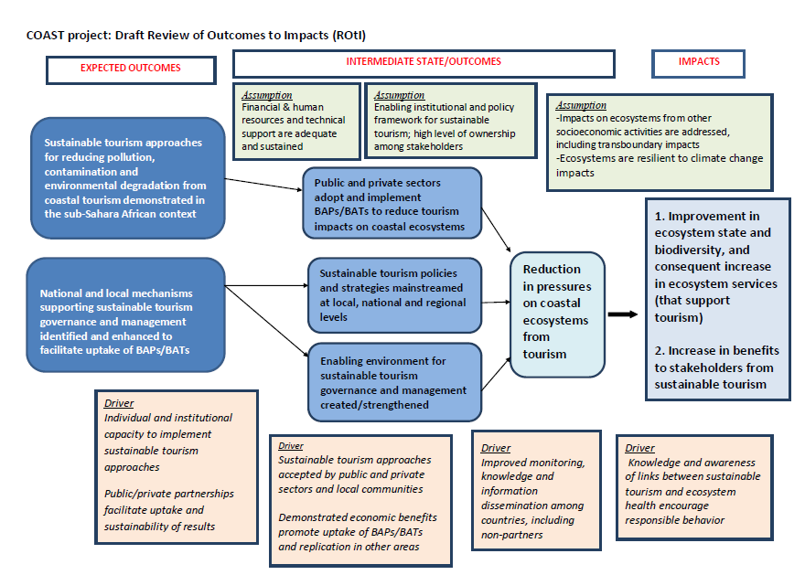

Slide 10
The ROtI requires ratings for outcomes achieved and the progress made towards the ‘intermediate states’ at the time of the evaluation (A – D, combinations).
This is intended to recognize project preparation and conceptualization that considers its own assumptions, and that seeks to remove barriers to future scaling up and out.
For example:
A: The project’s intended outcomes were delivered, and were designed to feed into a continuing process, with specific allocation of responsibilities after project funding
D: No measures taken to move towards intermediate states.

Slide 11
A project receiving an “AA” rating appears likely to deliver impacts
For a project receiving a “DD”, this would be very unlikely, due to low achievement of outcomes and limited likelihood of achieving the intermediate states needed for eventual impact

Slide 12
Next steps
Interviews with countries and partners
Site visits
Draft evaluation report prepared and submitted to UNEP Evaluation Office
Report circulated for comments to all partners
Comments addressed by evaluator (if rejected, evaluator must explain why)
Report finalized and submitted to UNEP

Slide 13
Thank you!

