Slide 1
6th STEERING COMMITTEE MEETING Mahe, Seychelles 11-14 June, 2014 COAST PROJECT FINAL LEGACY DOCUMENTS (SCM Day 1: 11 June 2014)
Hugh Gibbon & Marla McCarroll Pinto Rodrigues
Regional & HQ Technical Coordinators
COAST Project

Slide 2
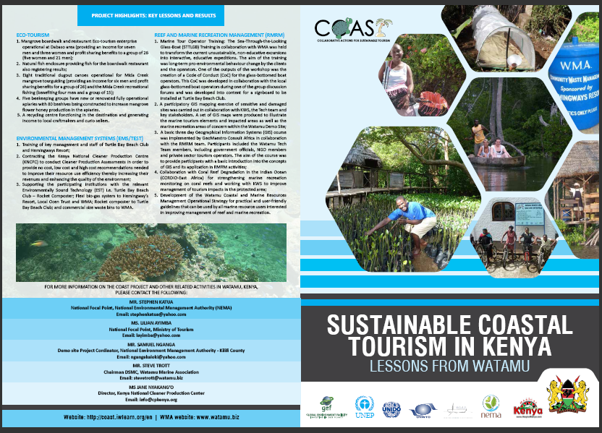
Country FACT SHEETS & MAPs
In close consultation with each country, the team has prepared a fact sheet for each COAST project country, inclusive if a map.
55 copies have been printed per country and you are now receiving these for your to take back to your country.

Slide 3
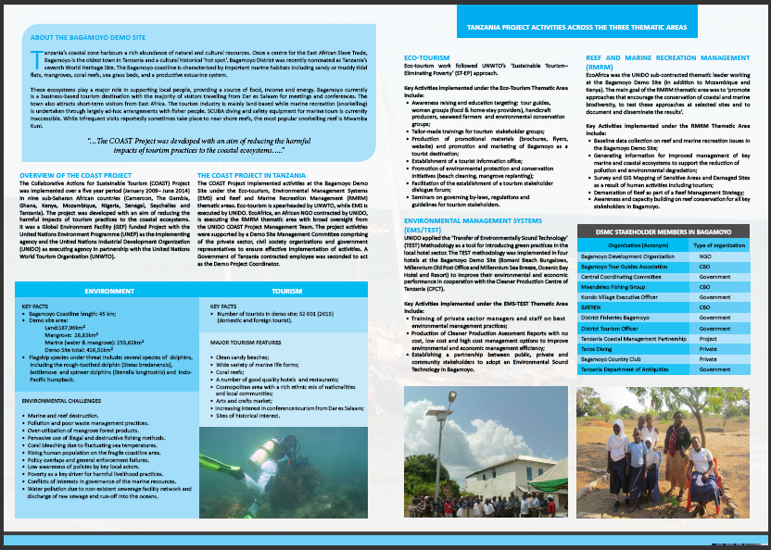
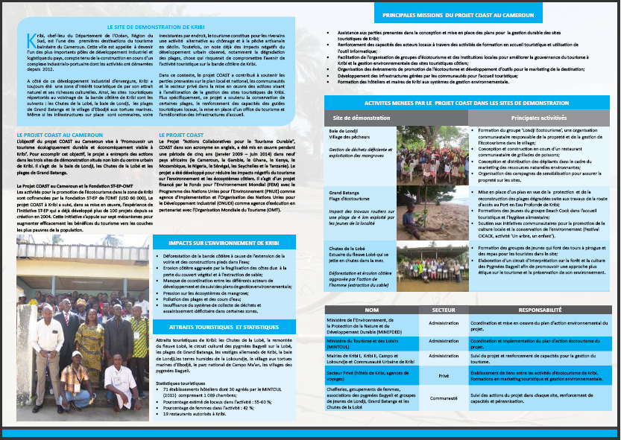
Country FACT SHEETS & MAPs

Slide 4
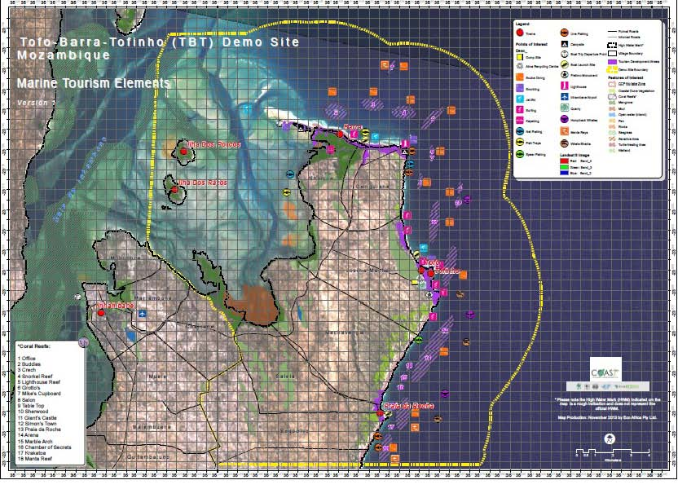
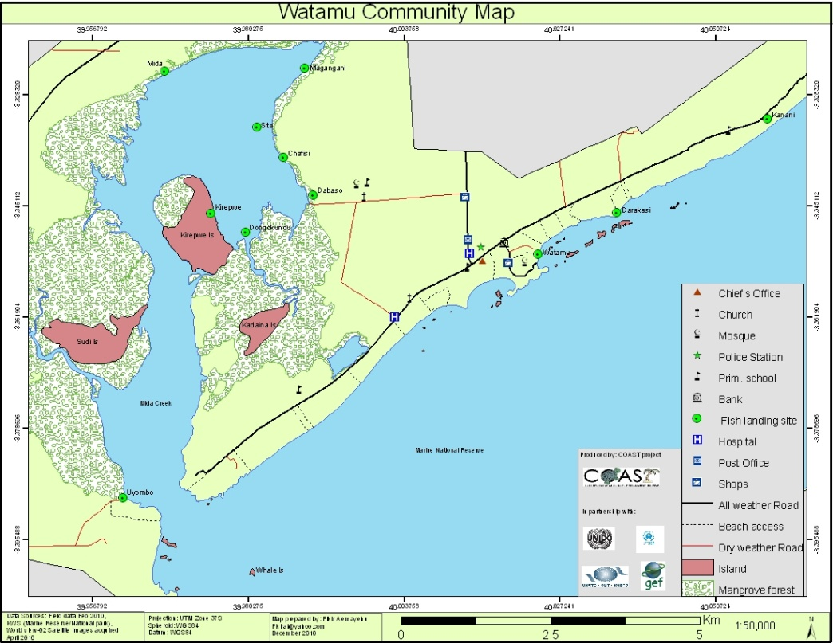
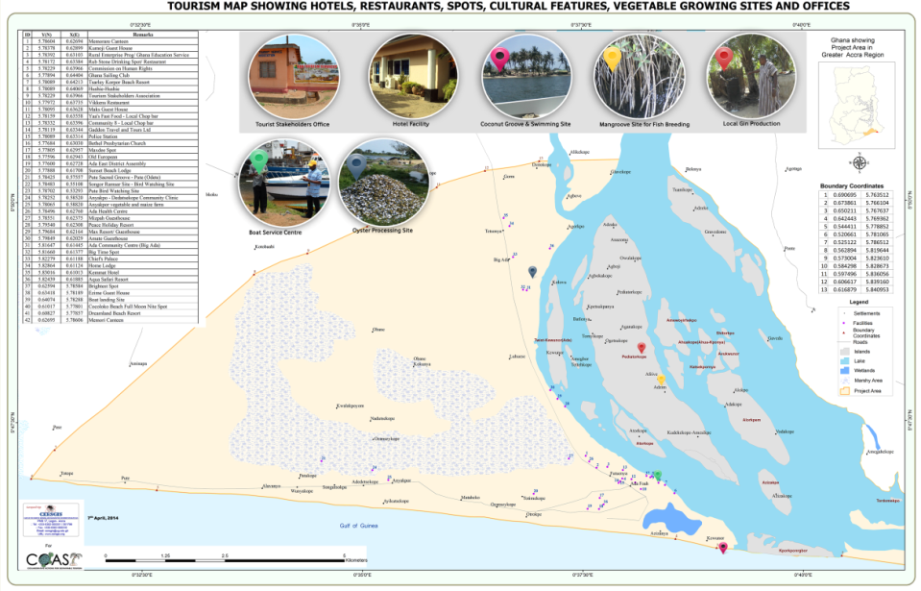
Country FACT SHEETS & MAPs

Slide 5
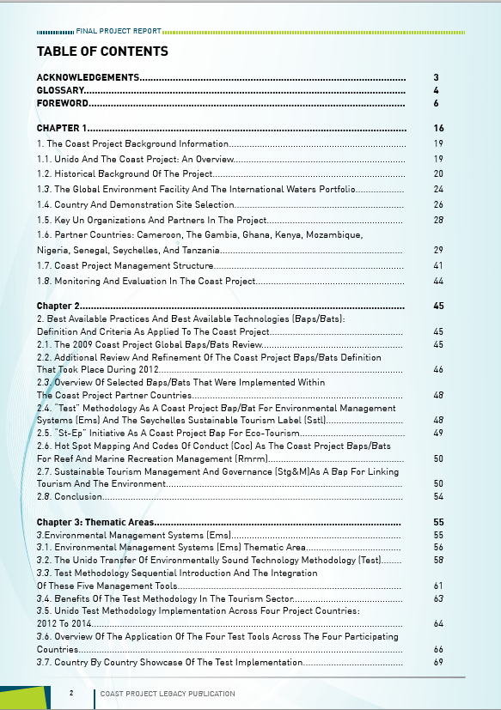
Final Project Report - Overview

Slide 6
Final Project Report – CONTENTs
CHAPTERS | DESCRIPTION
1 | Background Information about the project (Historical; Global Forums & Efforts; Partner Agencies, Countries, Consultants / experts; Pre & Post MTE; Project Management & Implementation Structure; Monitoring & Evaluation)
2 | Best Available Practices and Best Available Technologies (BAPs/BATs)
3 | Thematic Area Chapters: Environmental Management Systems / UNIDO Transfer of Environmentally Sound Technology Methodology (EMS / TEST)
4 | EcoTourism
5 | Reef and Marine Recreation Management (RMRM)
6 | Sustainable Tourism Management and Governance (STG&M)
7 | Knowledge Management and Communications (KM&C)
8 | Selection of Country Case Studies on Results, Lessons and Experiences
9 | Conclusion

Slide 7
Final Project Report – Selection of Country Case Studies
Countries Showcased | Title of Case Study
Cameroon | WORKING TO HARMONIZE INDUSTRIAL INFRASTRUCTURE AND THE NATURAL ENVIRONMENT FOR SUSTAINABLE COASTAL TOURISM IN AFRICA: A CASE STUDY OF KRIBI, CAMEROON
The Gambia | INTEGRATING RESPONSIBLE TOURISM PRINCIPLES IN THE DEVELOPMENT OF A COASTAL DESTINATION: A CASE STUDY OF KARTONG IN THE GAMBIA
Ghana | STRENGTHENING THE MANAGEMENT OF COASTAL PROTECTED AREAS THROUGH THE PROMOTION OF ECO-TOURISM: A CASE STUDY FROM ADA INCLUDING THE SONGHOR LAGOON BIOSPHERE RESERVE, GHANA
Kenya & Tanzania | STIMULATING ECONOMIC-ENVIRONMENTAL BENEFITS THROUGH THE WORK OF THE NATIONAL CLEANER PRODUCTION CENTERS IN THE COASTAL HOTEL SECTOR OF KENYA AND TANZANIA

Slide 8
Final Project Report – Selection of Country Case Studies - continued
Countries Showcased | Title of Case Study
Kenya & Tanzania | SHOWCASING ENVIRONMENTALLY SOUND TECHNOLOGY (EST) IN KENYA AND TANZANIA
Mozambique | Featured in the EMS/TEST chapter
Nigeria | PARTNERSHIPS IN THE SUSTAINABLE MANAGEMENT OF TOURISM AREAS: A CASE STUDY FROM BADAGRY, NIGERIA
Senegal | INTRODUCING SUSTAINABLE PRACTICES IN A PLANNED COASTAL DESTINATION: A CASE STUDY FROM SALY, IN SENEGAL
Seychelles | SEYCHELLES SUSTAINABLE TOURISM LABEL (SSTL)

Slide 9
Final Project Report – Selection of Text Boxes throughout the Report
Countries Showcased | Text Box
Kenya | Table 15. Overview of Selected CPA Recommendations and Projected Economic and Environmental Benefits for Kenya
Kenya, Tanzania | Table 36. Special Text Box on Enhancing Women Participation and Livelihood Diversification in the Tourism Value Chains in East Africa
The Gambia | Table 60. Special Text Box on Sandele Eco Retreat
Cameroon, Kenya, Ghana, The Gambia, Senegal | Table 56. Special Text Box on Applying Web-raising Principles under the COAST Project
Senegal | Table 28. Overview of EST in Senegal

Slide 10
Final Project Report – Annexes
Annex | Title of Case Study
1 | Pre MTE Logical Framework
2 | Post MTE Logical Framework
3 | Demo Site Selection Criteria
4 | Financial Information
5 | KM&C products and materials produced
6 | Summary of COAST project training events
7 | Full list of consultancies undertaken
8 | Maps of Demo Sites generated under the COAST project
9 | References

Slide 11
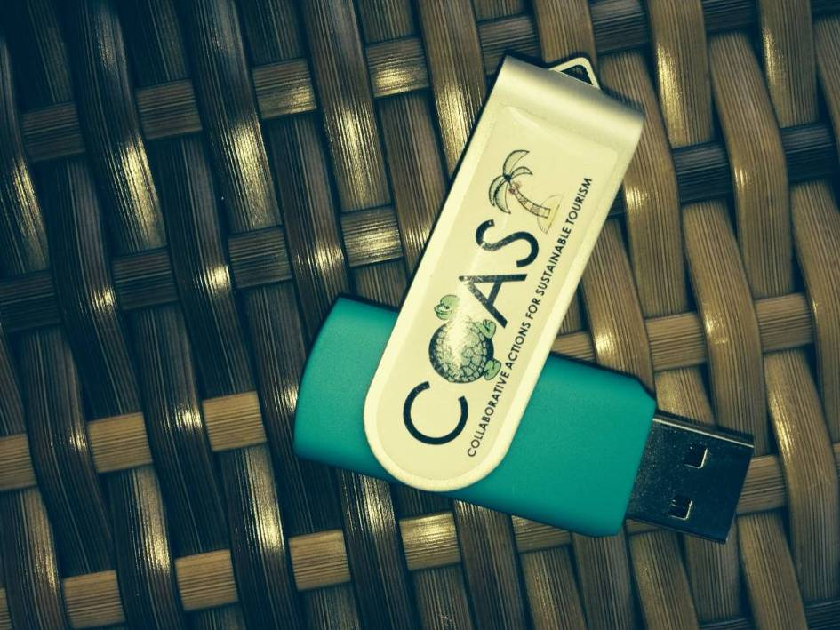
Final Project USBs with files
All SCM 6 power point presentations, files and photos will be uploaded on Friday onto 8GB COAST project USBs for your to take away with you.
The country fact sheets and maps are also contained in these files.

Slide 12
- T H A N K Y O U -

