Slide 1
6th Steering Committee Meeting
Reef & Marine Recreation Management
(RMRM)
RESULTS AND LESSONS
Kenya, Tanzania, Mozambique
13th June, 2014
Prof Francois Odendaal
Dr. Bernice McLean
Mr. Jonathan Kingwill
Ms. Jayshree Govender
Ms. Violet Njambi Ogega
Mr. Gabriel Marime
In collaboration with DSMC Members in TBT, Bagamoyo and Watamu

Slide 2
OUTLINE
Situation
Introduction
RMRM Components
RMRM Participatory Planning Process
Results: Mozambique, Tanzania, Kenya
Sustainability Management Plans/Strategies
Lessons
Feedback from the Demo Site

Slide 3
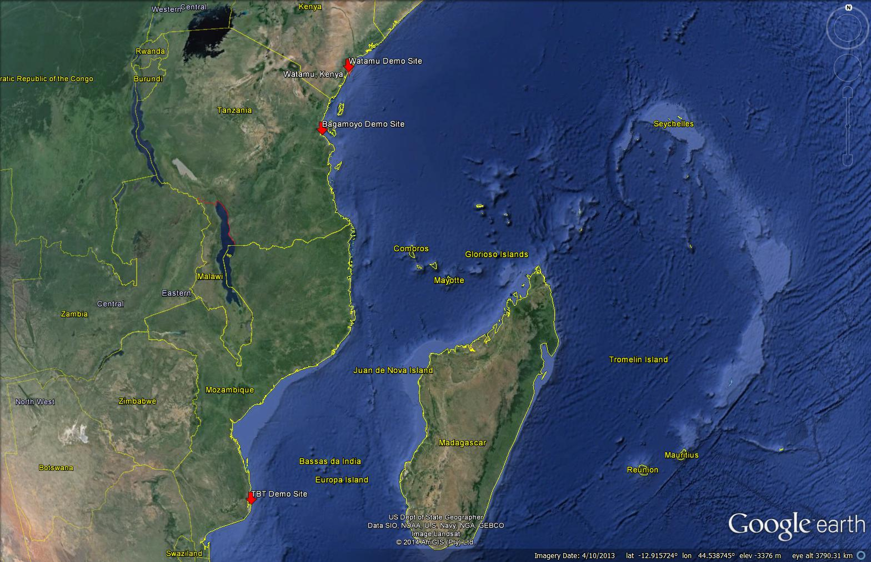

Slide 4
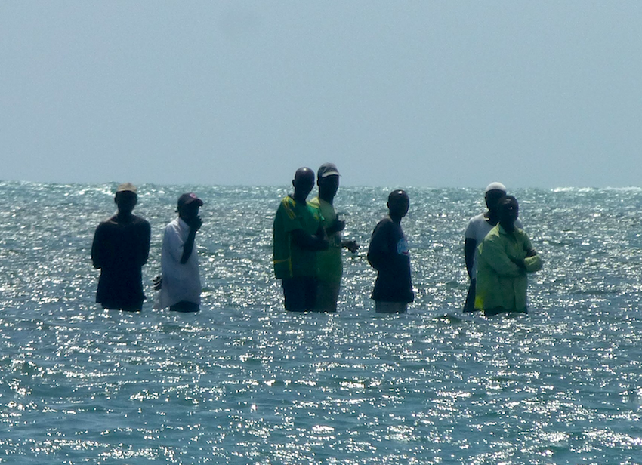
SITUATION
The tourism sector relies directly upon healthy and productive marine and coastal ecosystems for long-term sustainability
Many other pressures also threaten marine ecosystem health
Activities degrading the marine resource base include:
Over-utilisation of marine and coastal resources
Destructive activities in sensitive ecosystems
Poorly planned and unmanaged coastal development and use
Rampant poverty, increasing fishing pressures and rising conflicts between users, exacerbate the threats to the sensitive ecosystems
Weak governance and the limited collaboration among the stakeholders further contribute to threats facing coastal areas

Slide 5
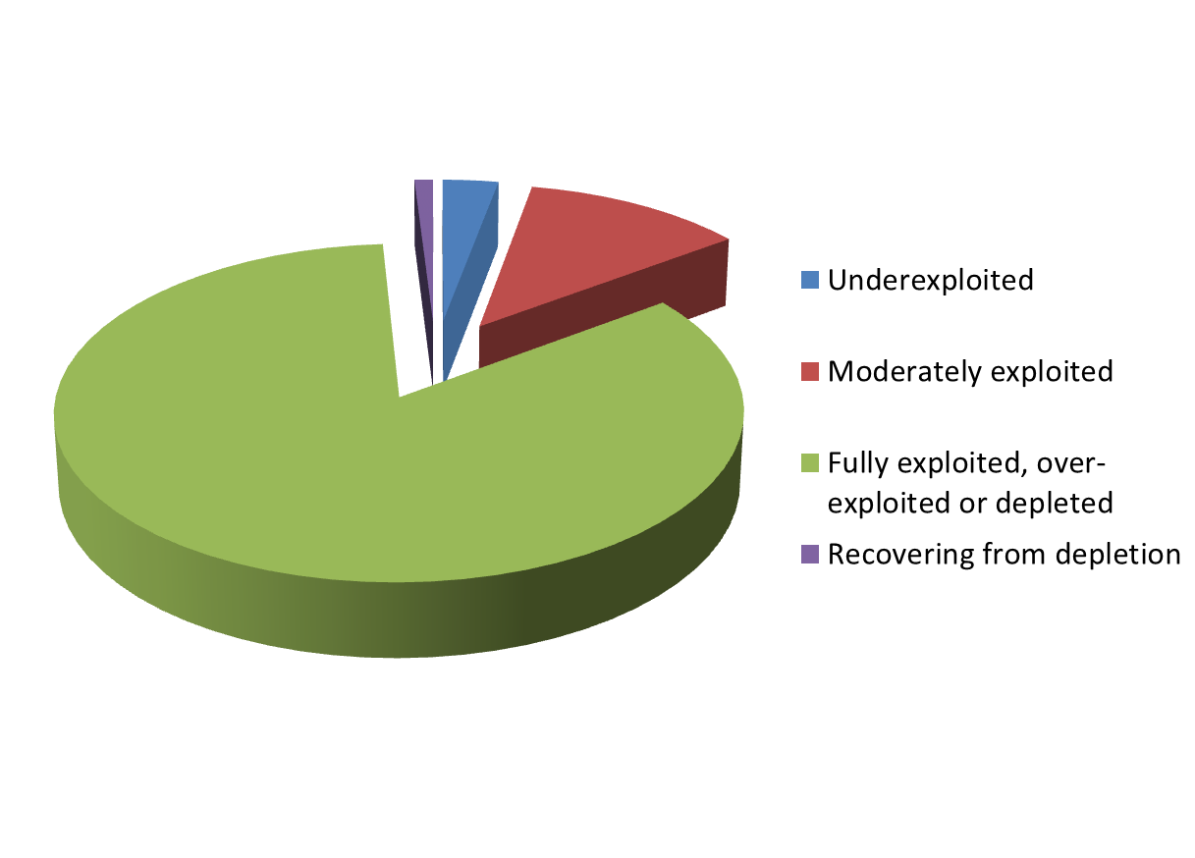
GLOBALLY
83% of global commercial fish stocks fully or over-exploited (FAO, 2012)

Slide 6
INTRODUCTION
Reef & Marine Recreation Management (RMRM)
      Three Demo Sites: Watamu (Kenya), Bagamoyo (Tanzania), Tofo-Barra-Tofinho (TBT) (Mozambique)
      Implemented by EcoAfrica Environmental Consultants in collaboration with the DSMC / Tech Teams
      Objective: Responsible reef & marine recreation management for sustainable tourism promoted & tested at selected sites, results documented & disseminated

Slide 7
RMRM COMPONENTS (Post MTE)
Component 1: Baseline Data Collection
Component 2: Design, Development & Implementation of Project Briefs
Component 3: Survey & GIS Mapping of Sensitive Areas & Damaged Sites
Component 4: Demarcation as part of a Reef & Marine Management Strategy
Component 5: Sustainability/Management Plan
Component 6: Awareness & Capacity Building (CB) on Reef & Marine Management
Component 7: Project Management, Facilitation & Monitoring & Evaluation

Slide 8
PARTICIPATORY PLANNING PROCESS
Baseline Research
DSMC input
Development of Project Brief including BAPs & BATs Review
Stakeholder meetings
DSMC input
BAPs & BATs Workshop
DSMC input
Preliminary Assessments & Follow Up Workshops
Stakeholder meetings
DSMC input
Assess Roles & Responsibilities of DSCM & Key Partners
Stakeholder meetings
DSMC input
Demarcation & Mapping Process
Stakeholder meetings
DSMC input
Sustainability Management Planning
Stakeholder Meetings
DSMC input
Final RMRM Sustainability Management Plan/Strategy
Notes:
8

Slide 9
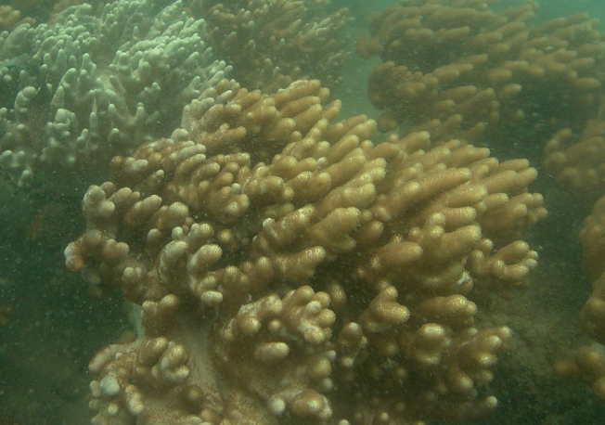
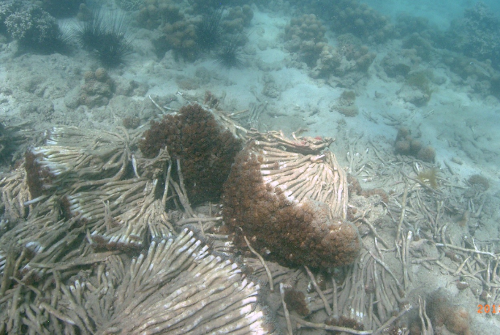
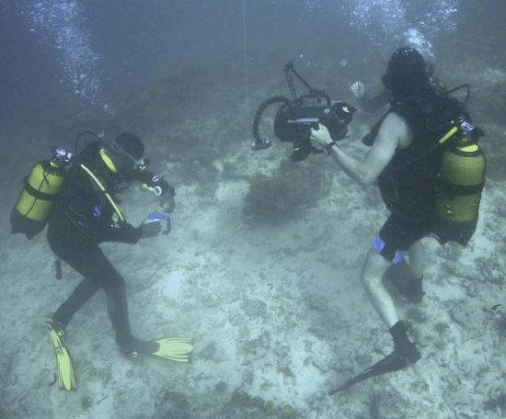
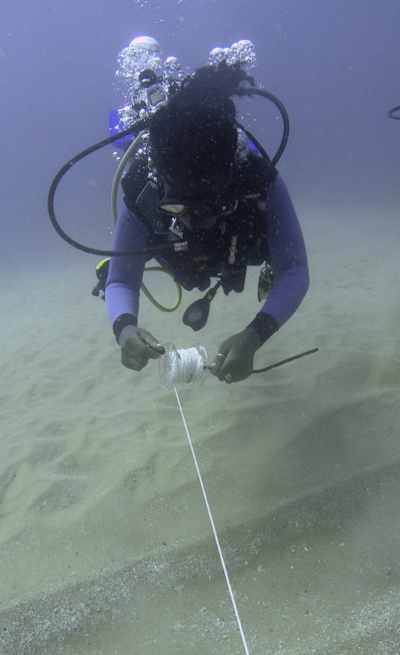
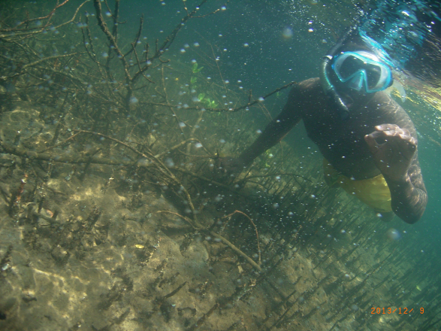
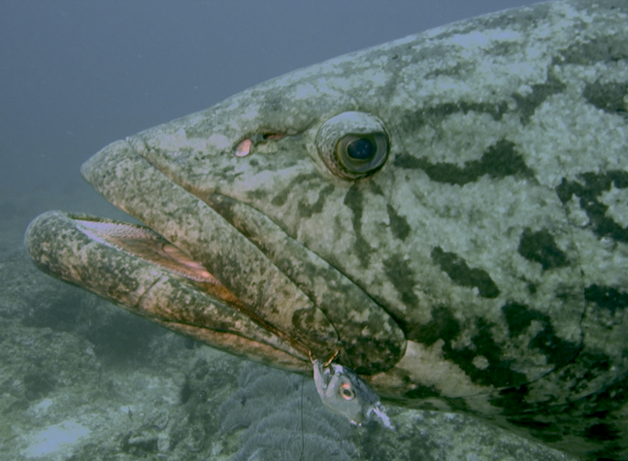
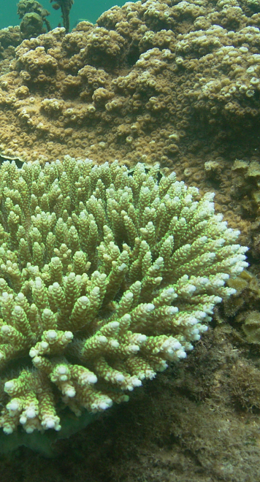
ECOSYSTEM ASSESSMENT

Slide 10
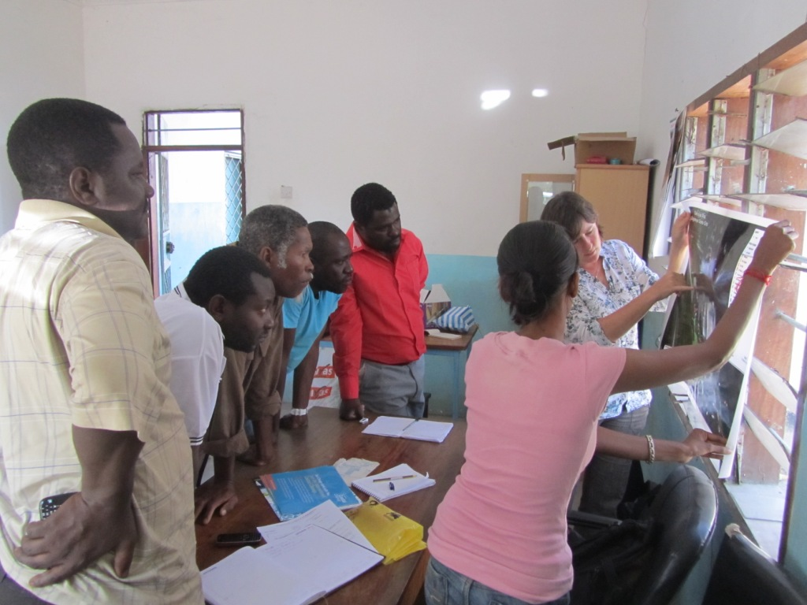
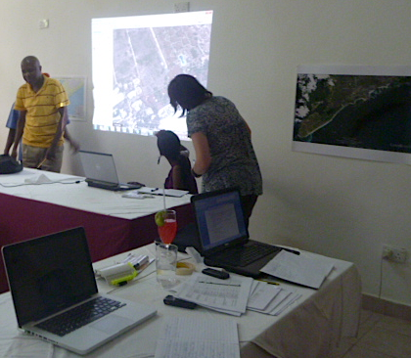
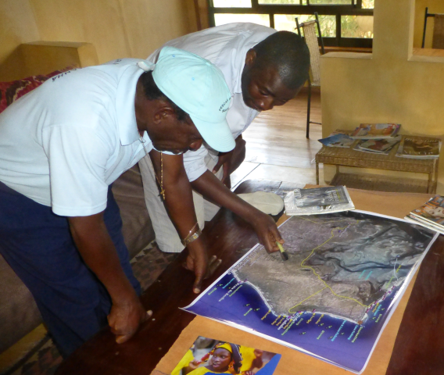
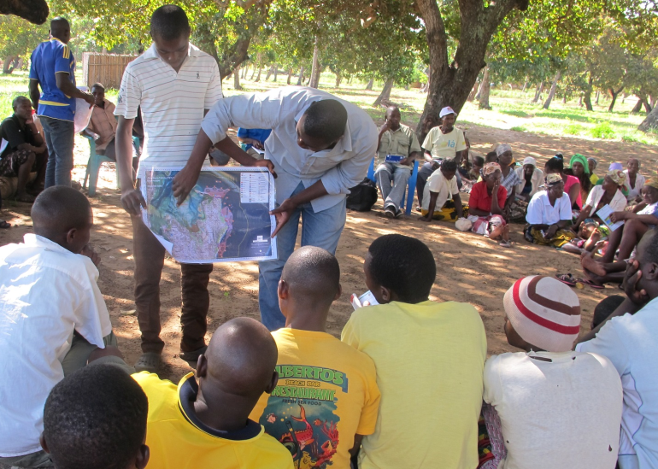
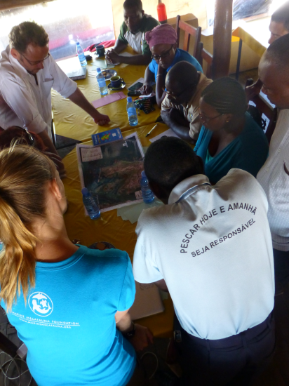
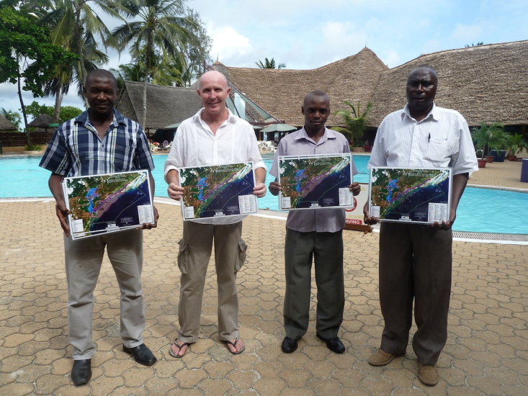
PARTICIPATORY MAPPING

Slide 11
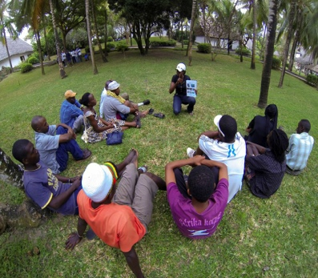
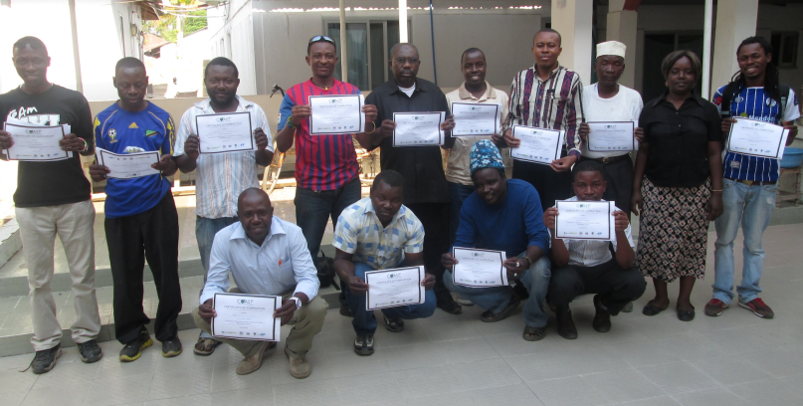
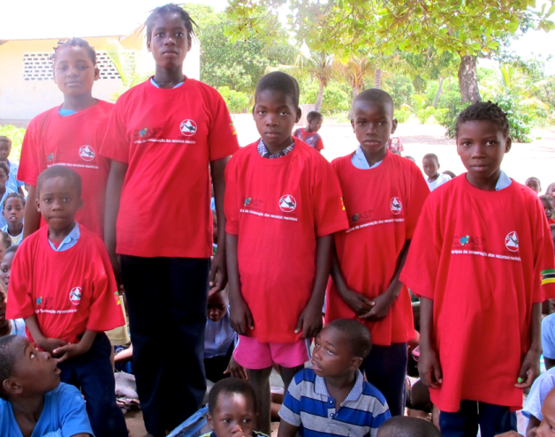
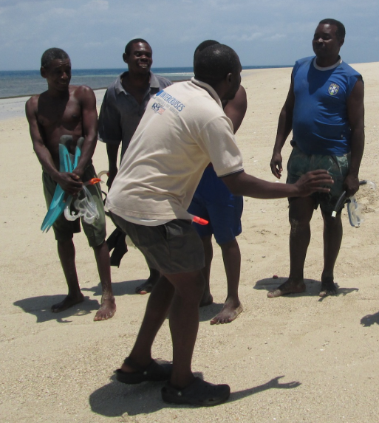
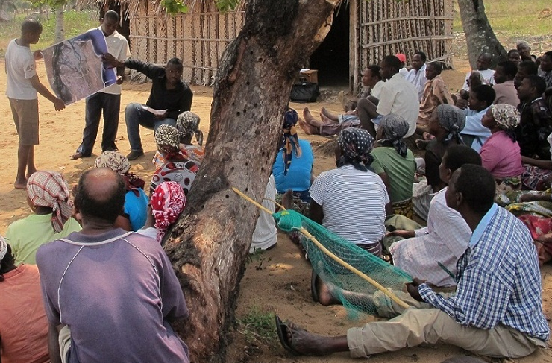
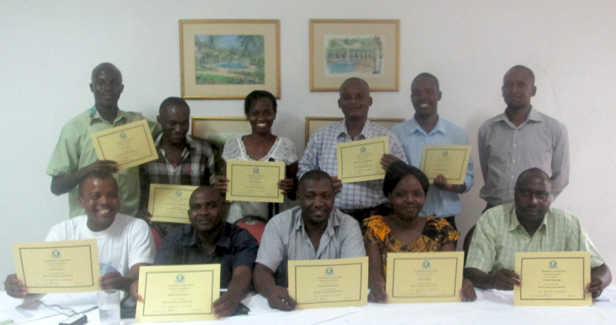
CAPACITY BUILDING

Slide 12
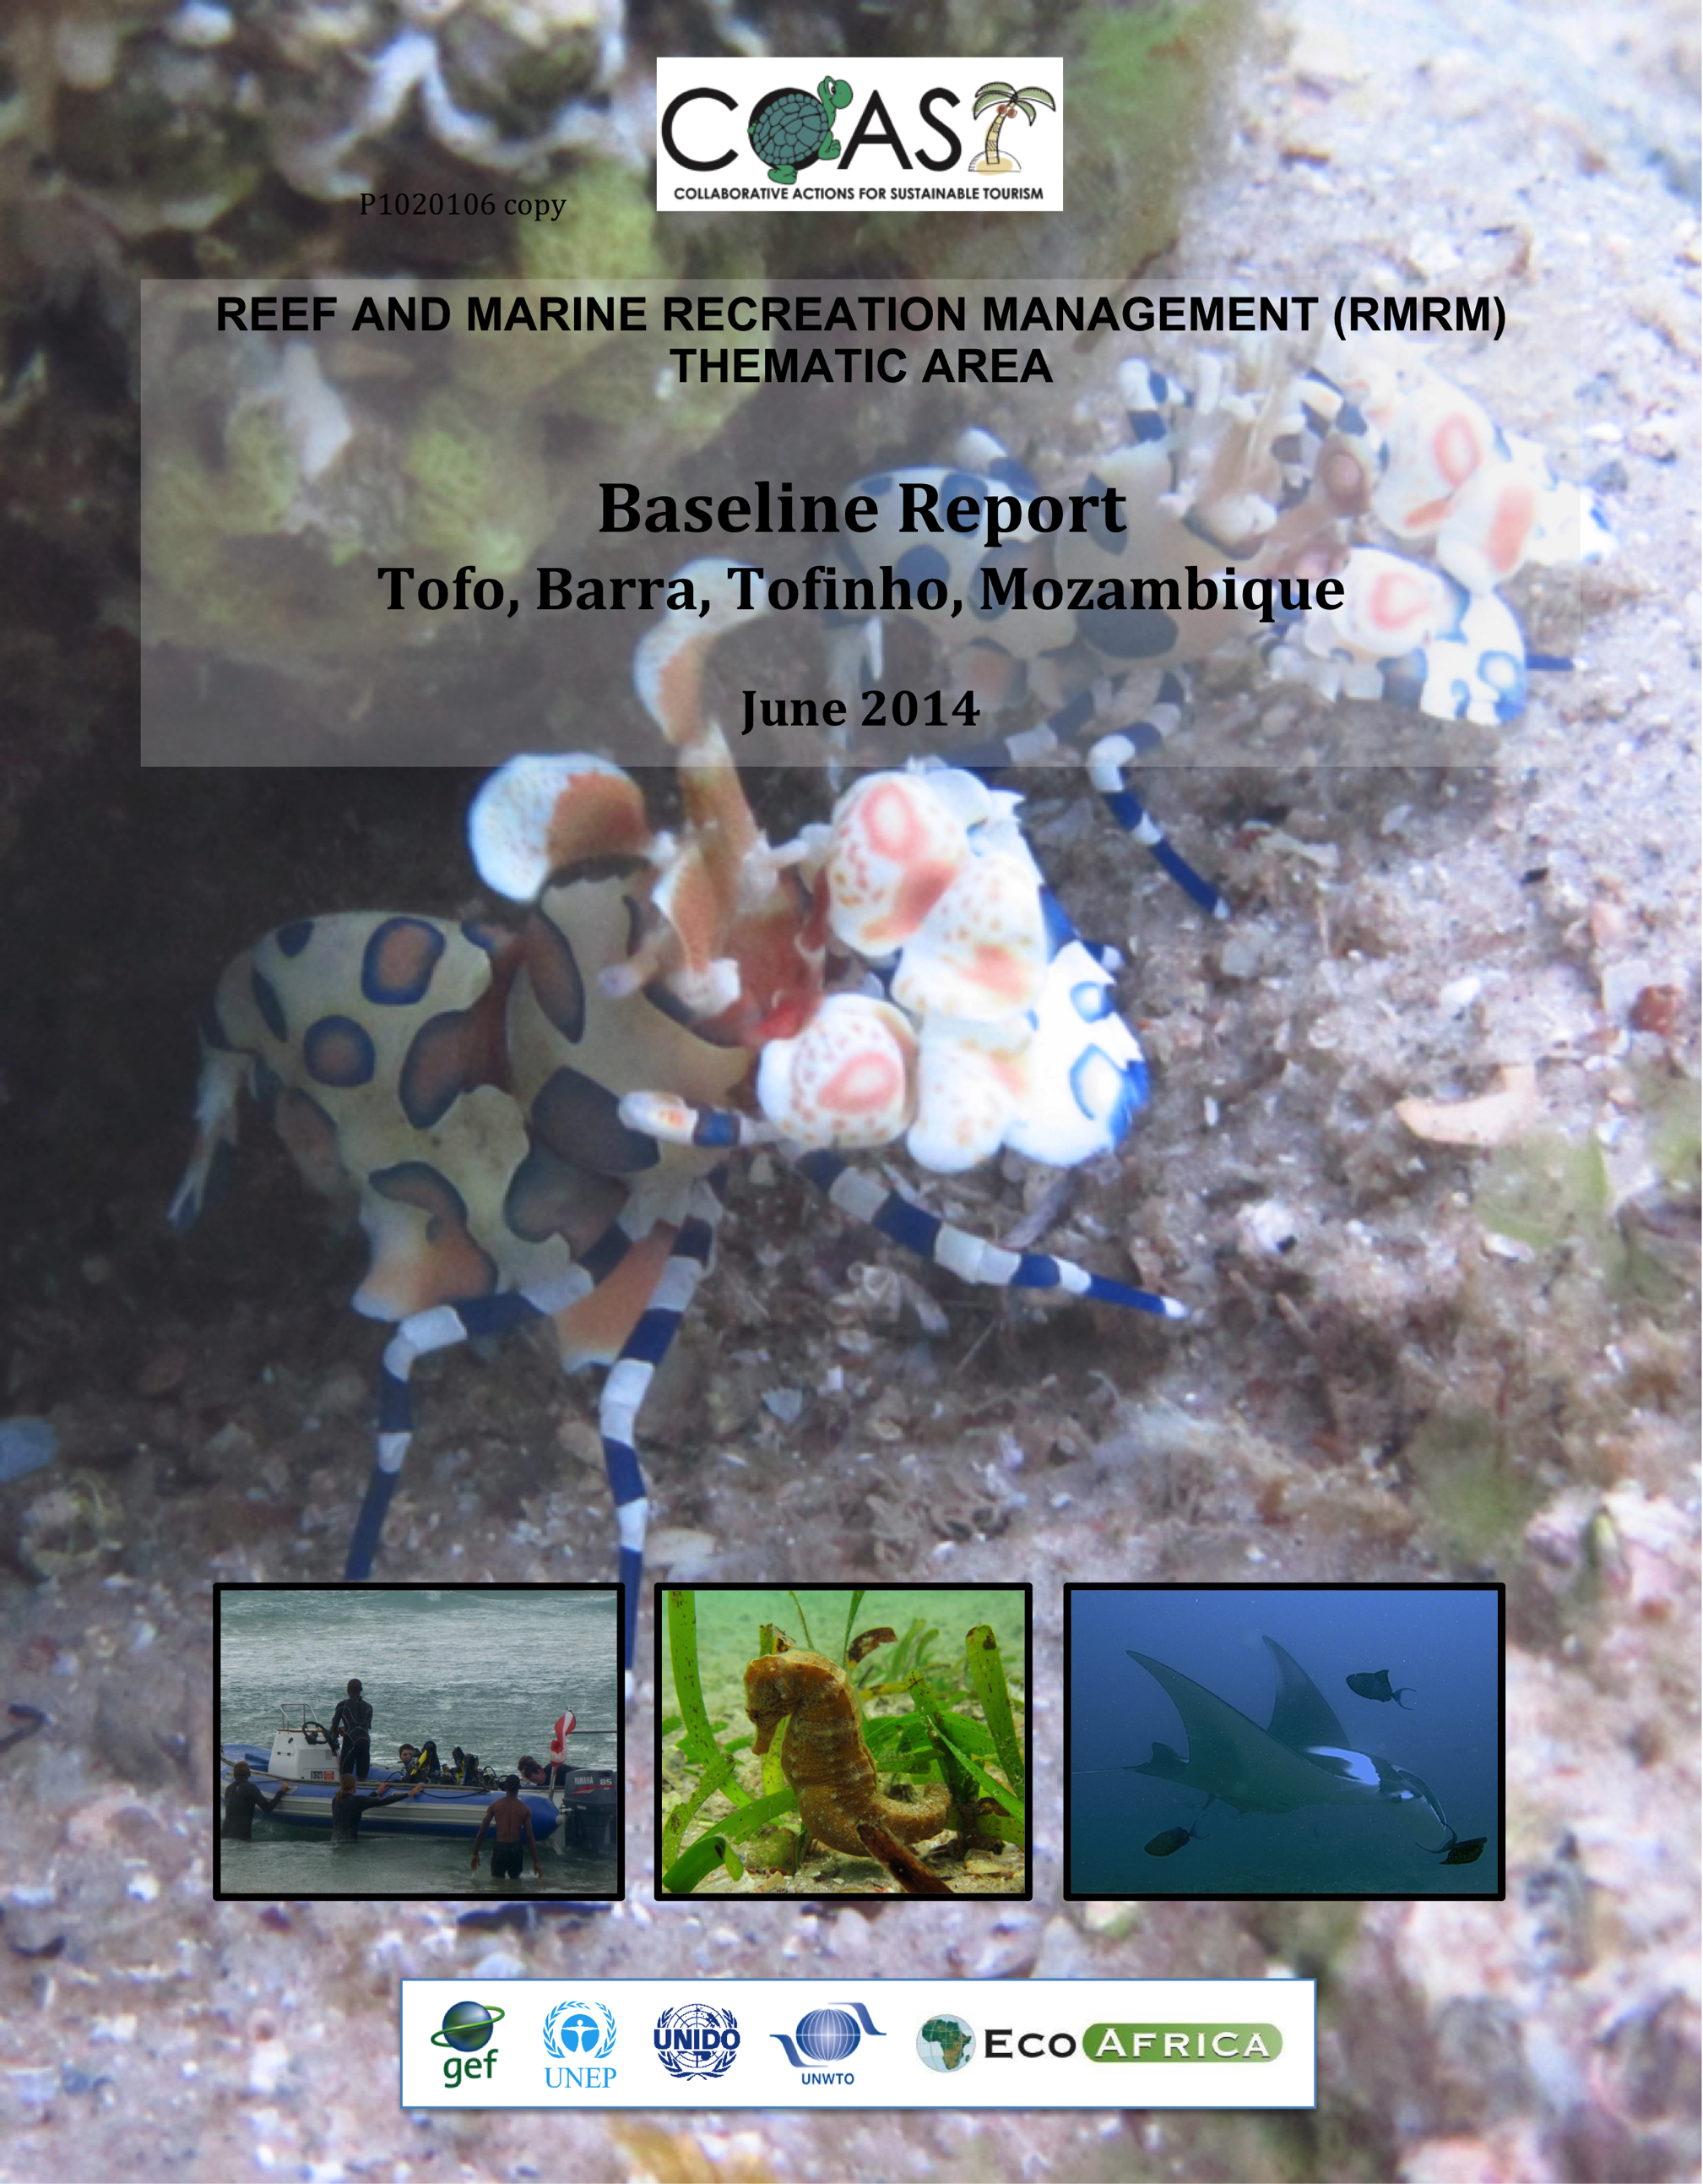
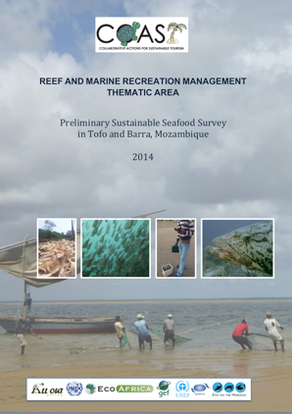
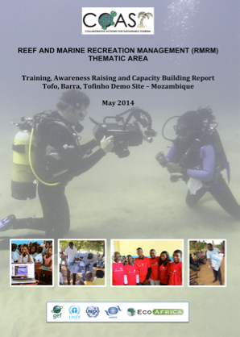
MOZAMBIQUE RESULTS

Slide 13
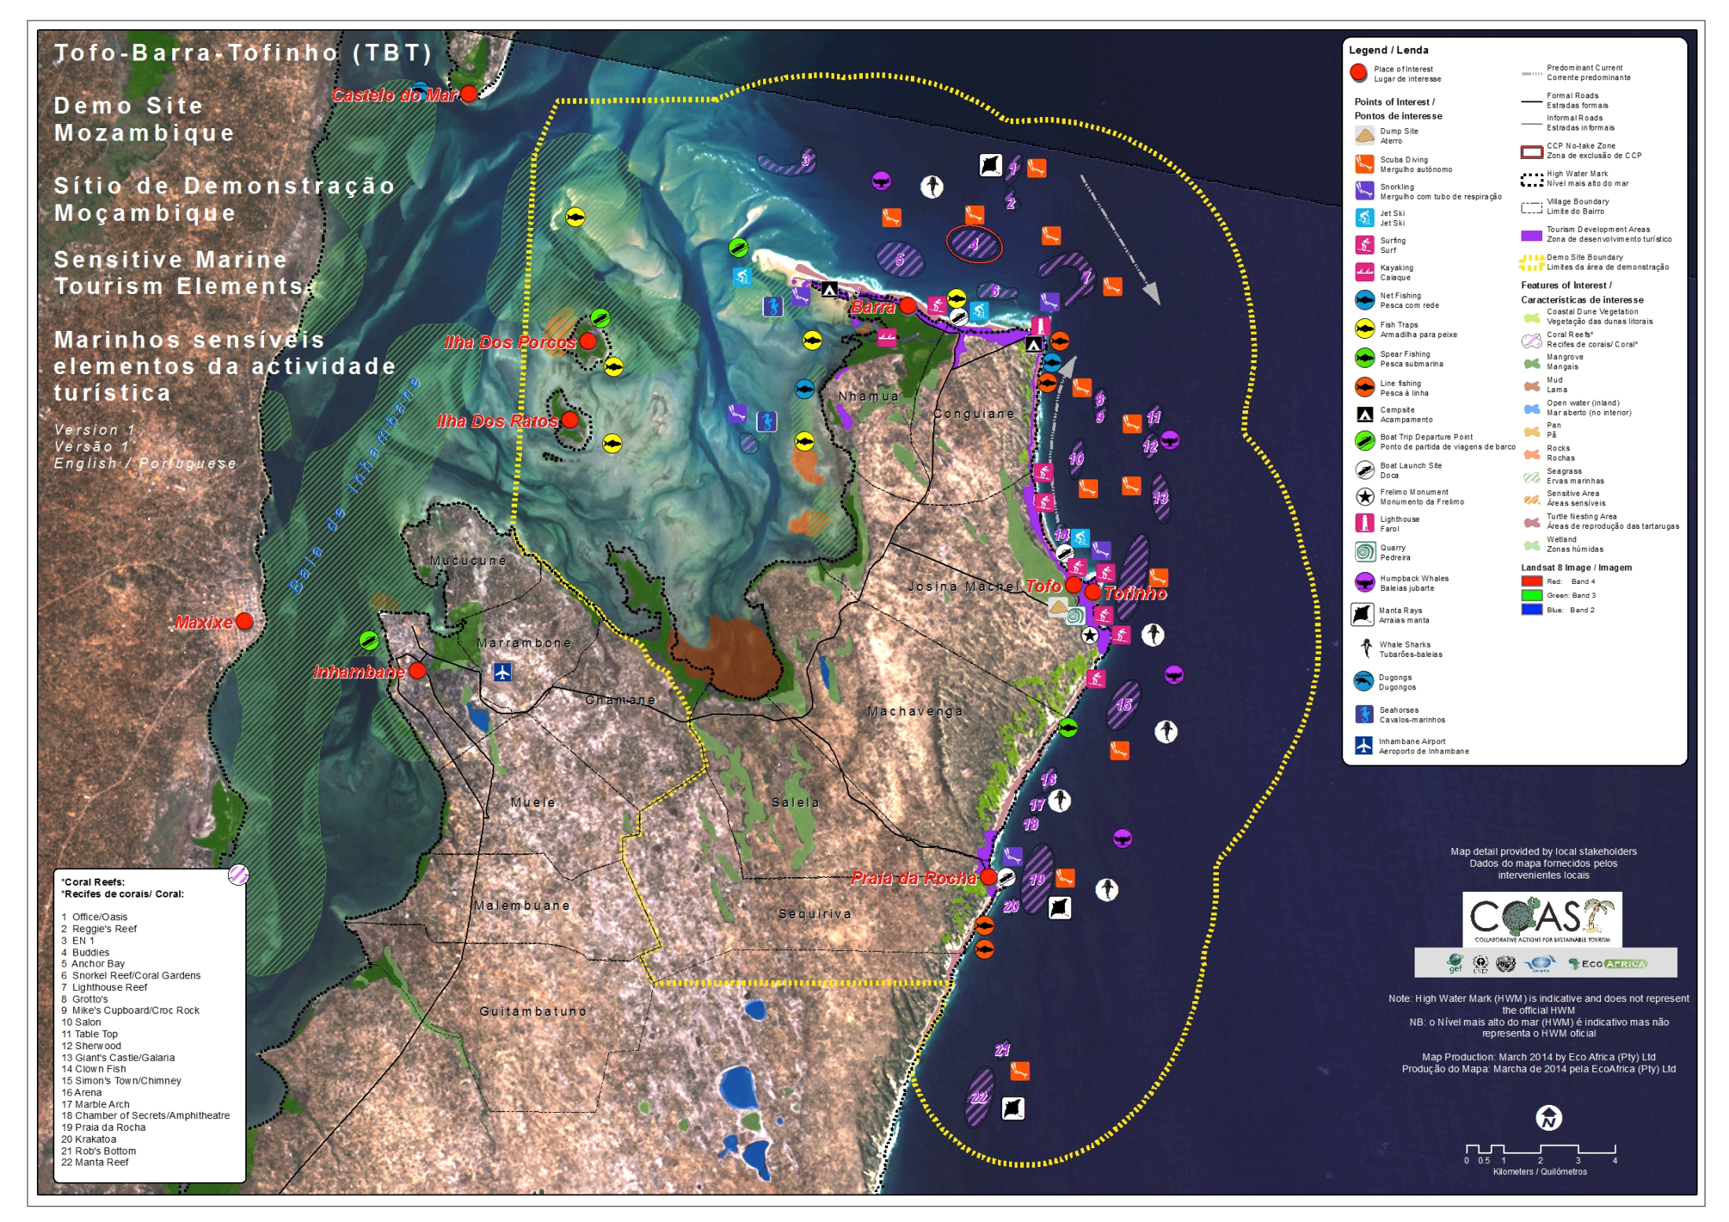

Slide 14
RESULTS: TBT DEMO SITE
Tourism use: high usage by marine tourism sector
Management: CCP locally managed reef, no formal protected area, proposals for locally managed marine area, Marine World Heritage Site potential
Threats: high/improper tourism, destructive fishing, no protection measures, lack of food security & poverty
Marine recreation: beach, SCUBA, safaris, snorkelling, sports fishing, motor boats, jet-skis, estuary tours, surfing
Collaboration: conflict between and lack of communication amongst stakeholders, high private sector competition

Slide 15
TRAINING, AWARENESS RAISING AND CAPACITY BUILDING (TARCB)
TBT Demo Site
Reef and Marine Awareness Raising
Reef and Marine Tourism Management Capacity Building
Codes of Conduct (SCUBA, snorkeling, marine safaris)
Reef and Marine Ecology Training (Whale Shark focus)
Preliminary Sustainable Seafood Survey
Participatory Mapping
Partnership Strengthening
Sustainability Management Planning
Reef and Marine Tourism Short Film
Local Research Support

Slide 16
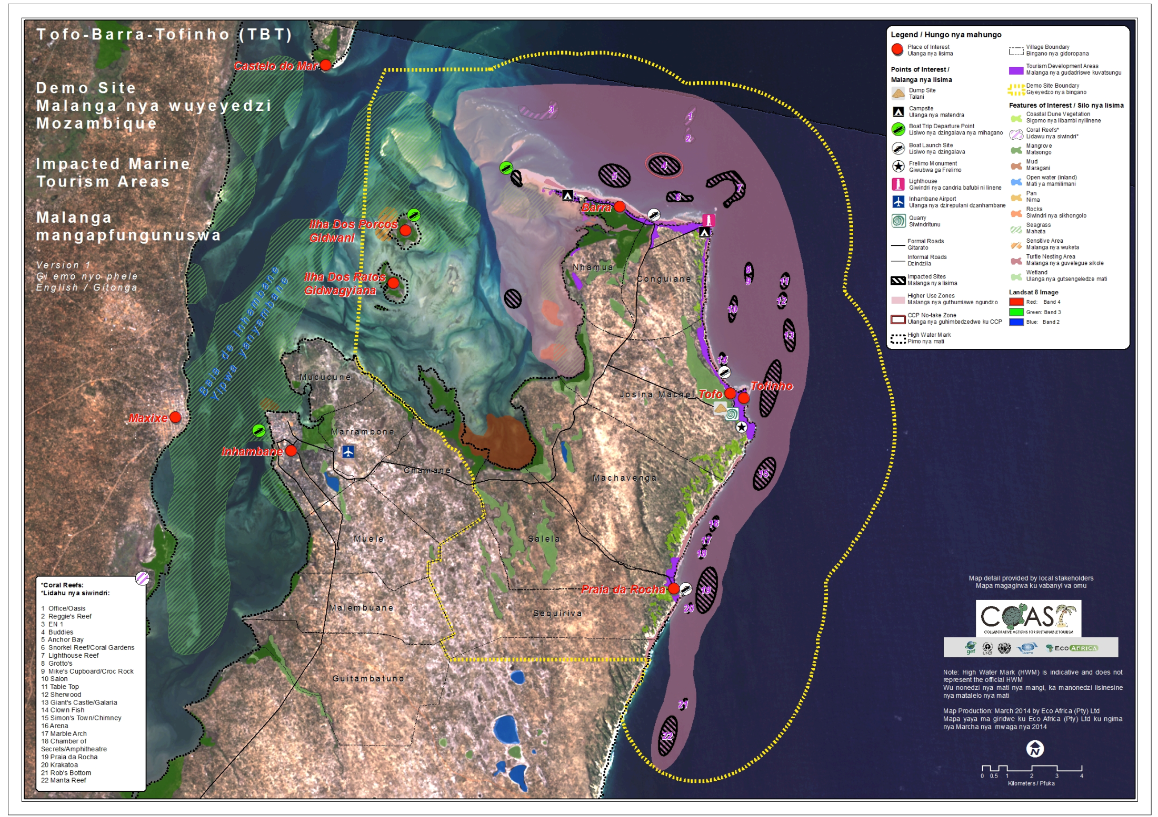

Slide 17
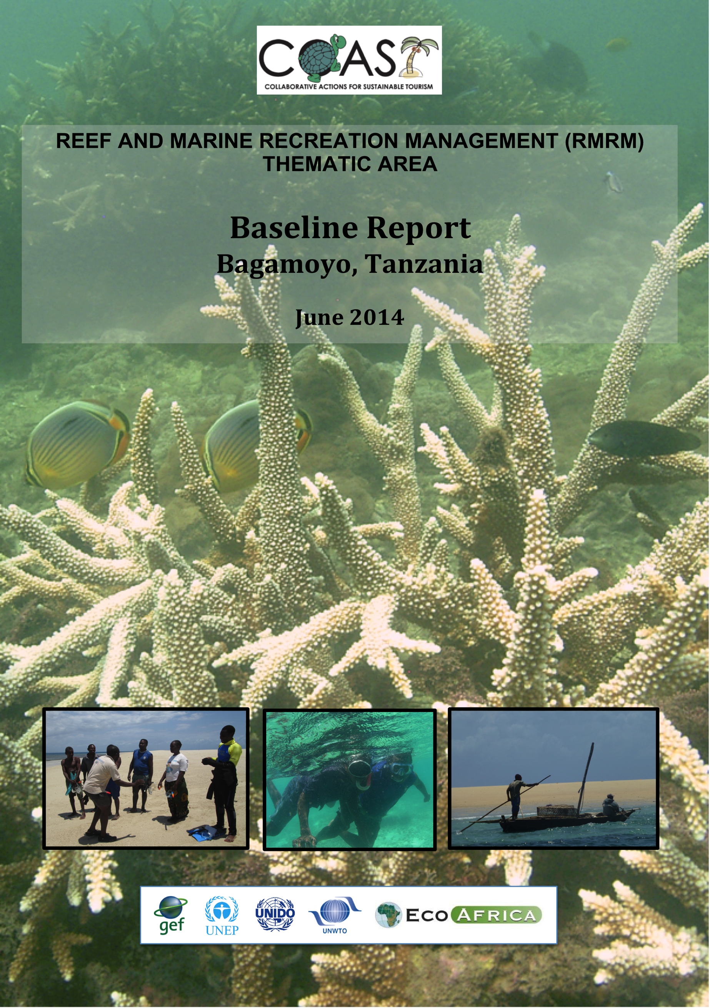
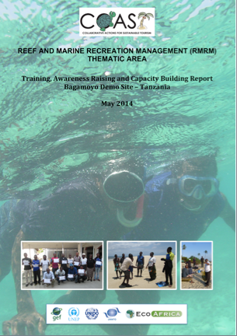
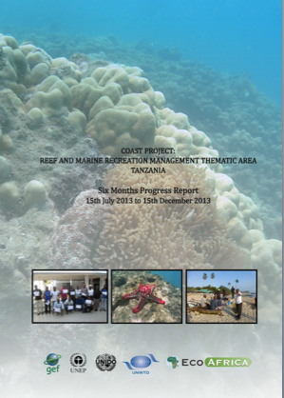
TANZANIA RESULTS

Slide 18
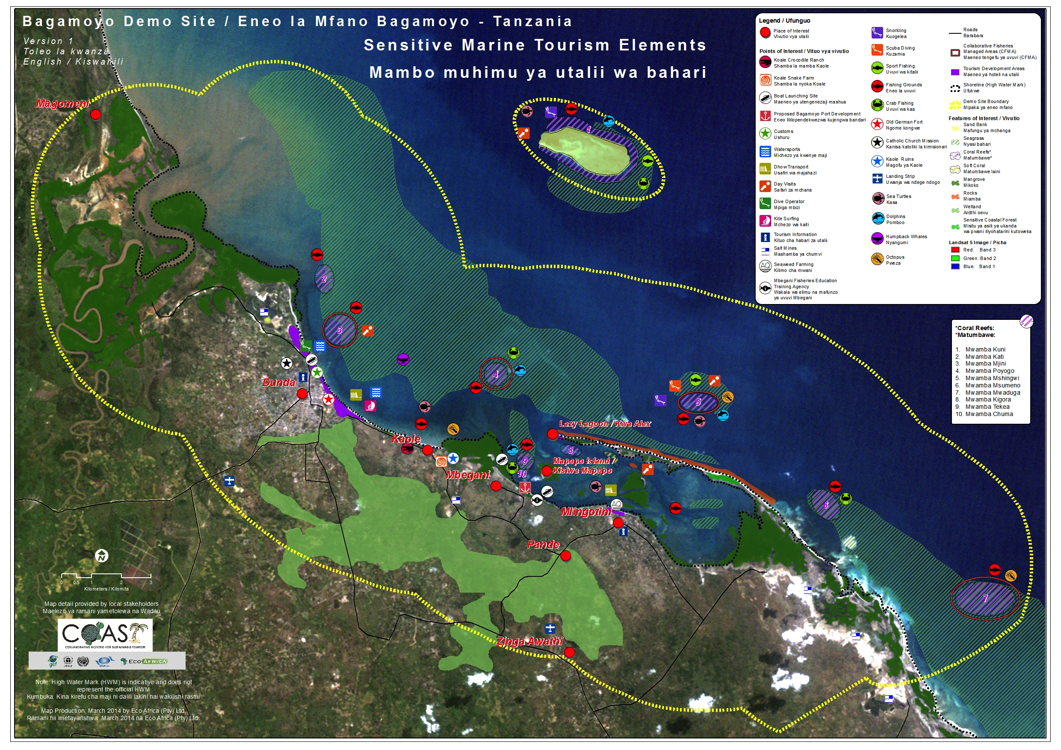
Tanzania map

Slide 19
RESULTS: Bagamoyo Demo Site
Tourism use: low usage by marine tourism sector, high potential for linkage between marine and cultural tourism
Management: CCC locally managed reefs (by-law), no marine protected area, lack of resources and capacity
Threats: destructive fishing, pollution, improper coastal development, proposed port development, lack of food security & poverty, no marine protection measures
Marine recreation: marine tours and limited diving, emerging activities
Collaboration: limited collaboration amongst stakeholders on marine tourism

Slide 20
TRAINING, AWARENESS RAISING AND CAPACITY BUILDING (TARCB)
Bagamoyo Demo Site
Marine Tour Guide Training
Reef and Marine Tourism Awareness Raising
Code of Conduct (marine tours)
Marine tourism safety protocol
Participatory Mapping
Partnership Strengthening
Sustainability Management Planning
Reef and Marine Tourism Short Film
Beach Clean-ups on International Coastal Clean-up

Slide 21
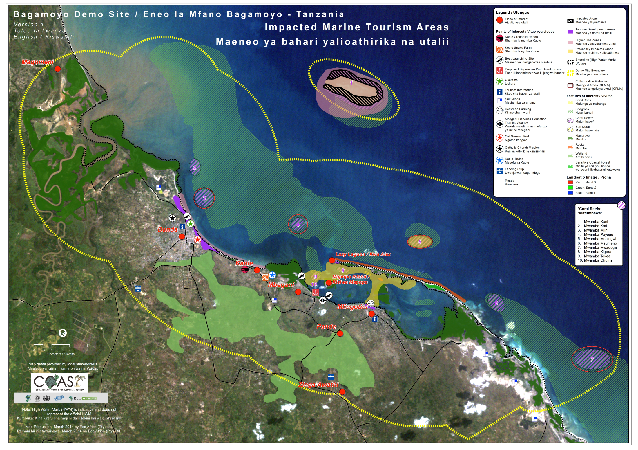
Tanzania map

Slide 22
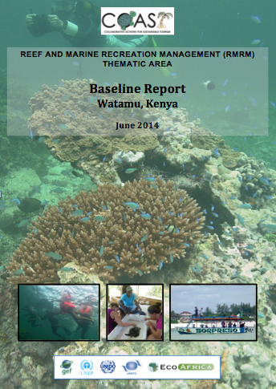
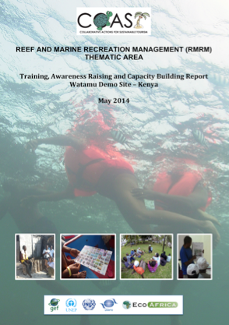
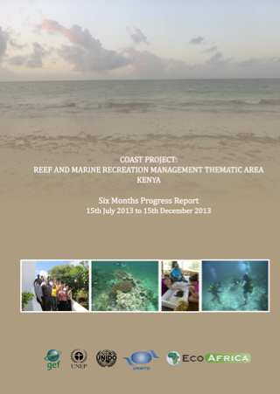
KENYA RESULTS

Slide 23
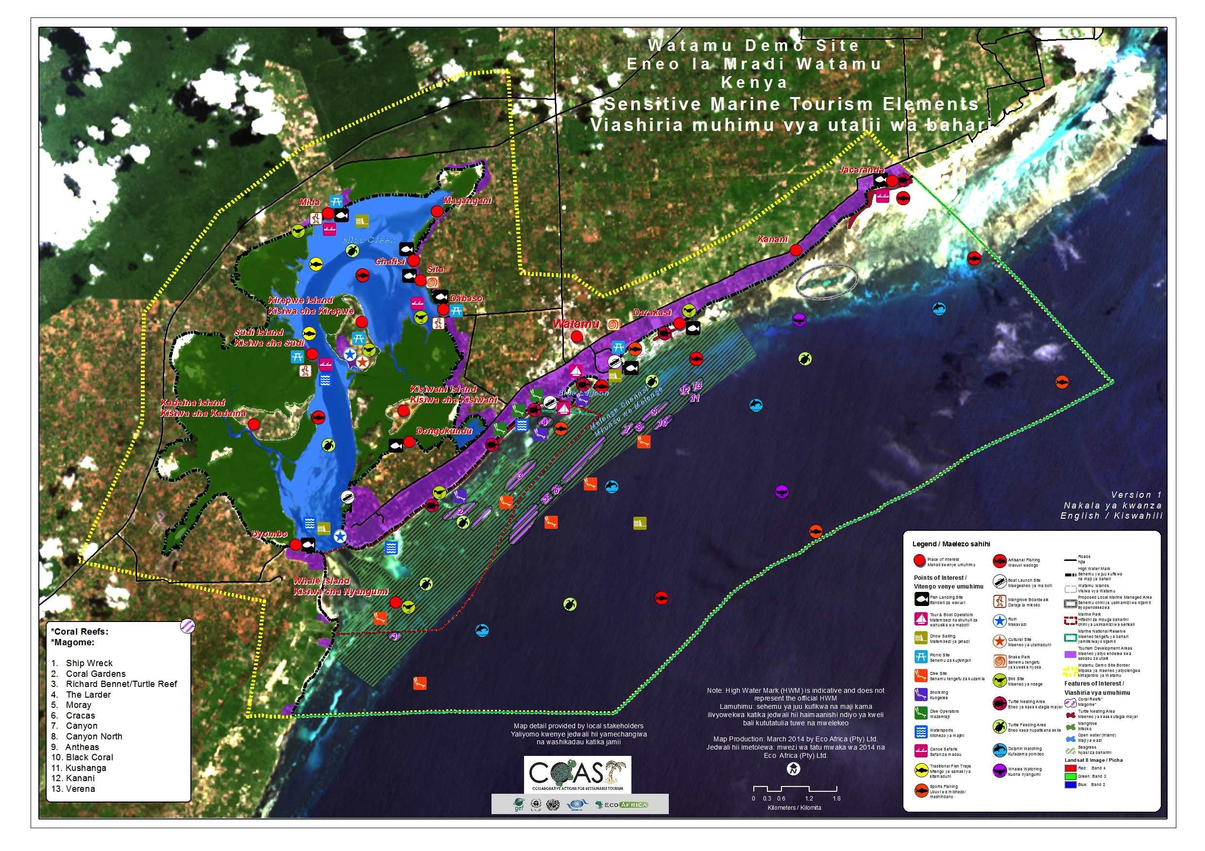
Kenya map

Slide 24
RESULTS: Watamu Demo Site
Tourism use: high useage by marine tourism sector
Management: formal marine protection under KWS, lack of resources
Threats: destructive marine tourism activities, conflict among stakeholders, pollution
Marine recreation: beach tourism, SCUBA, snorkelling, marine tours, sports fishing, kite surfing
Collaboration: high level of communication and collaboration amongst stakeholders

Slide 25
TRAINING, AWARENESS RAISING AND CAPACITY BUILDING (TARCB)
Watamu Demo Site
‘Sea through the Looking Glass Boat’ Training (WMA)
GIS Training (GeoMaestro Africa)
Reef Adaptive Management Training (CORDIO)
Code of Conduct (marine and snorkeling tours)
Participatory Mapping
Partnership Strengthening
Sustainability Management Planning
Reef and Marine Tourism Short Film

Slide 26
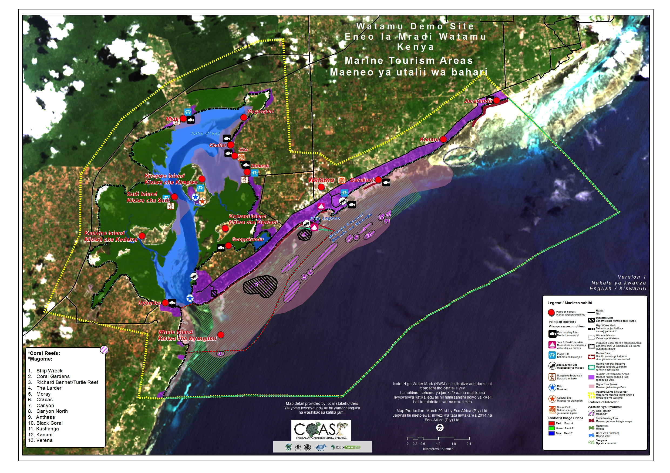
Kenya map

Slide 27
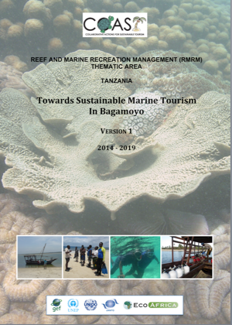
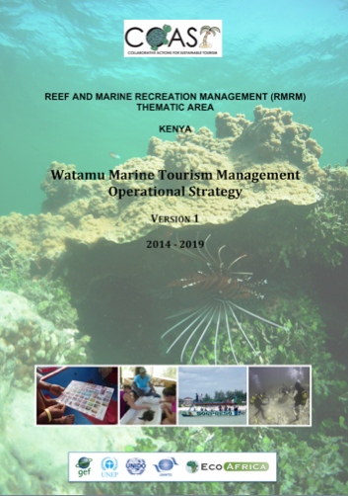
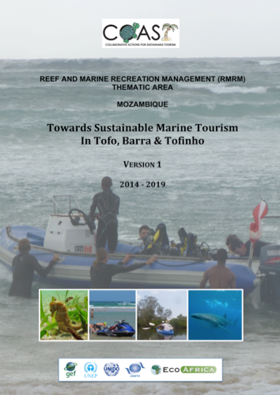
SUSTAINABILTY MANAGEMENT PLANS/STRATEGIES

Slide 28
SUSTAINABILITY PLANNING IMPLEMENTATION TABLE

Slide 29
LESSONS
Greater awareness on global ocean health, value of reefs & sensitive marine ecosystems, threats and linkages
Integrated management with local community centrally placed, as well as private sector engagement is essential
Monitoring of specific impacts (i.e. tourism activities) that informs adaptive management is essential
Further and increased capacity for management - critical
Future support for project outcomes – further implementation of Sustainability Management Plans/Strategies
Greater institutionalisation of governance mechanisms established during the project: clarifying roles and responsibility
Training, awareness raising and capacity building is essential regionally to improve governance

Slide 30
FEEDBACK FROM THE DEMO SITE

Slide 31
FEEDBACK FROM THE DEMO SITE

Slide 32
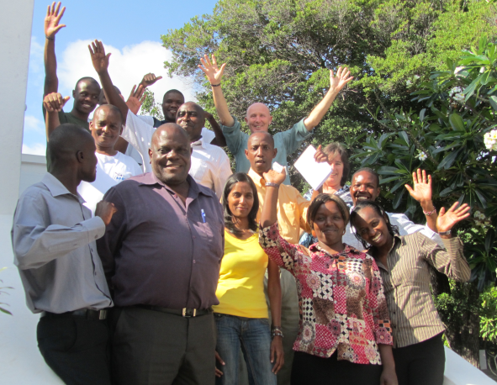
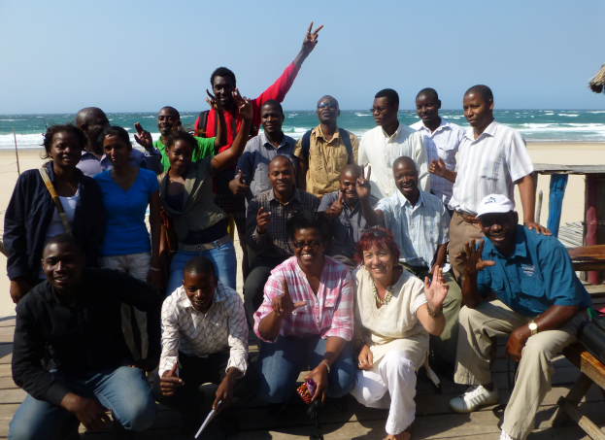
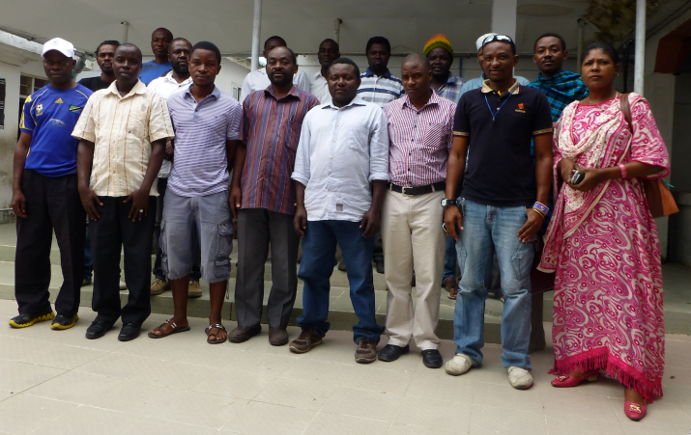
THANK YOU
ASANTE SANA
OBRIGADO
NIBONGIDE
Contacts:
Ms. Jayshree Govender
jayshree@ecoafrica.co.za
Ms. Violet Njambi Ogega
violet@ecoafrica.co.za
Contacts:
Mr. Jonathan Kingwill
jonathan@ecoafrica.co.za
Dr. Bernice McLean
bernice@ecoafrica.co.za
www.ecoafrica.co.za

Slide 33
PLENARY QUESTIONS
The model of the DSMC structure as a mechanism to coordinate activities and mainstream them into governance structures and processes within the site was a good concept. Has it worked?
The local reality of direct dependence on marine resources by local coastal communities drives ecosystem management and local economic development. How could a future project benefit from more direct engagement with the fisheries sector?

Slide 34
PLENARY QUESTIONS
The differing levels of awareness and education on marine resource use and conservation among different stakeholders at the Demo Sites resulted in an ad hoc approach to addressing broader awareness raising and capacity building through the RMRM activities to meet these local capacities and needs. Based on our experience, what would you do differently another time?
What have been the methods or best practices for sharing of Demo Site experiences across Partner Countries (and beyond) which have proved most effective - could these be improved upon?

Slide 35
PLENARY QUESTIONS
The design of the COAST project presented a challenge to enhancing communication between the different Thematic Areas and the requirement for strengthening cross linkages to build synergy – how well did we manage to achieve this?
There appears to be an almost complete disregard for the impacts of marine and coastal tourism on the sensitive marine ecosystems by the vast majority of private sector investors and operators – how can this change?

Slide 36
PLENARY QUESTIONS
Our experience shows that locally ‘owned’ stakeholder groupings (networks) can provide a suitable mechanism for bridging stakeholder participation, but participatory planning in the absence of such organisations present a challenge in most Demo Sites. What is your experience?
Conflicts over the use of marine resources are increasing in all of the Demo Sites, how would you overcome this key challenge to the sustainability of any future project?

