Slide 1
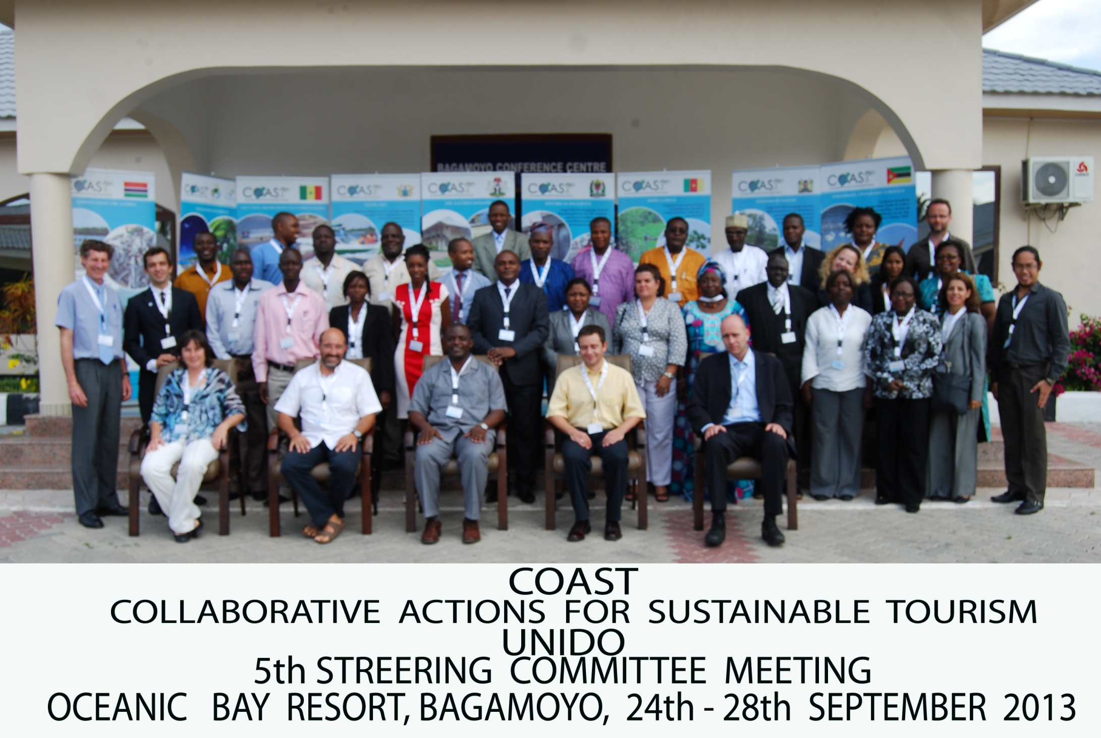

Slide 2
Colleagues without which the COAST project would not have been able to achieve the results that it has…
David Ahadzie
John Moemeke Zeloyi
Sunil Korah
Nataliya Vyshnevetska-Pynda
Fabisin Mainimo
Dr. Joel Sonne
Fadipe Sewanu Ashamu
Gatta Ba
Virginia Fernandez
Rostand Ewoma
Tonye Francois
Josiane Benot
Modou Lamin...
Harvey J. Garcia
Thomas Chali
Esther Munyithia
Baraza
Edoardo E. Zandri
Jayshree Govender
Violet Njambi
Dr. Julius Kenneth Ningu
Emelda Tekwa
Cidalia Mahumane
T H A N K Y O U
to them

Slide 3
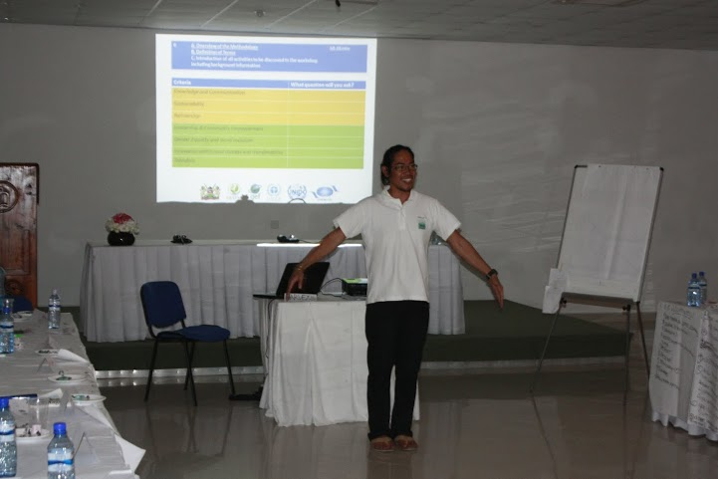
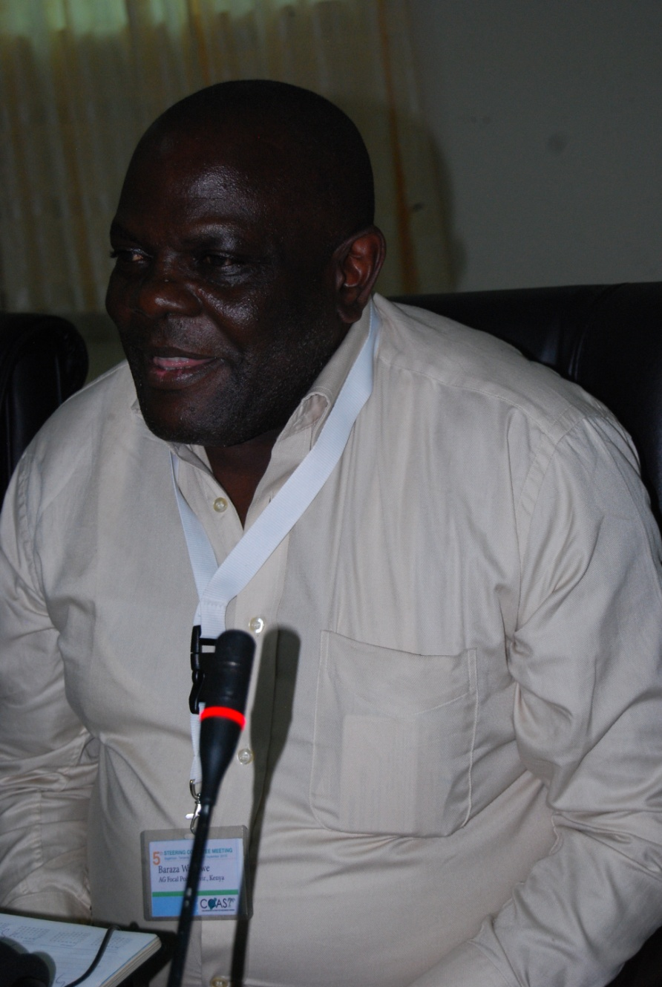
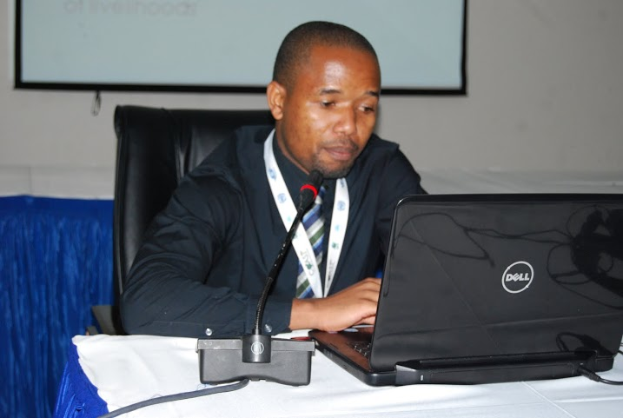
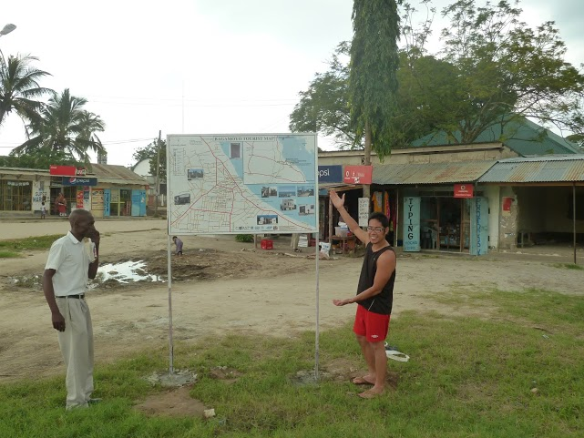

Slide 4
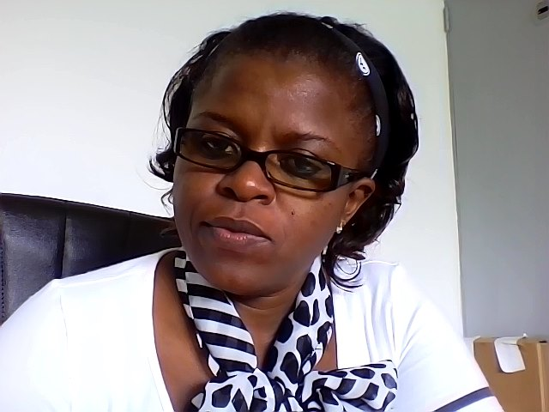
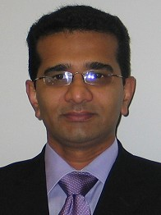
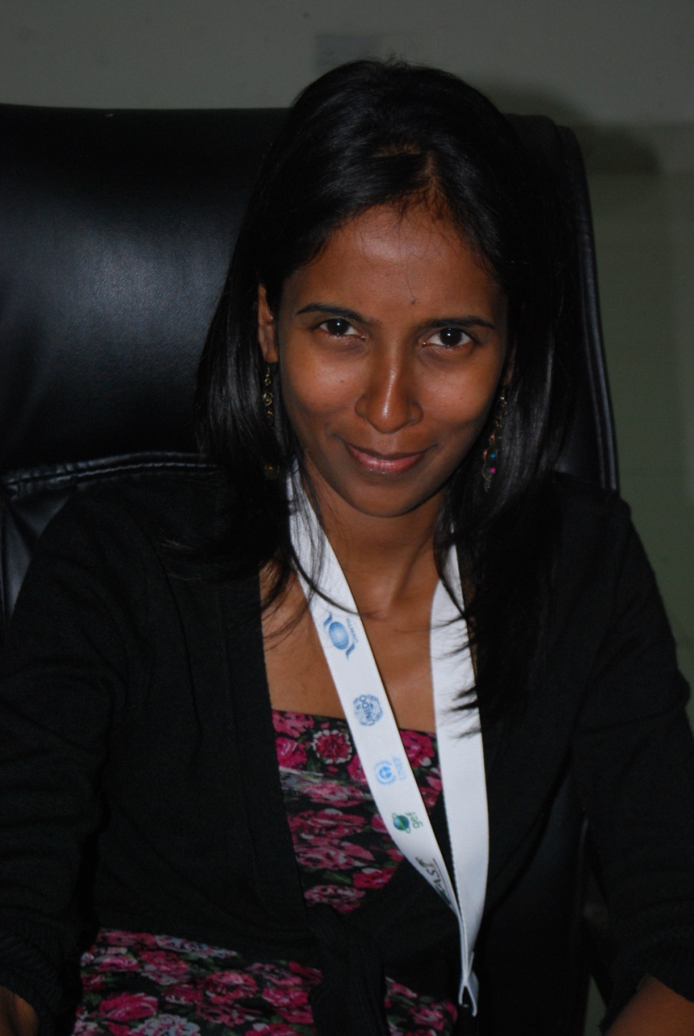
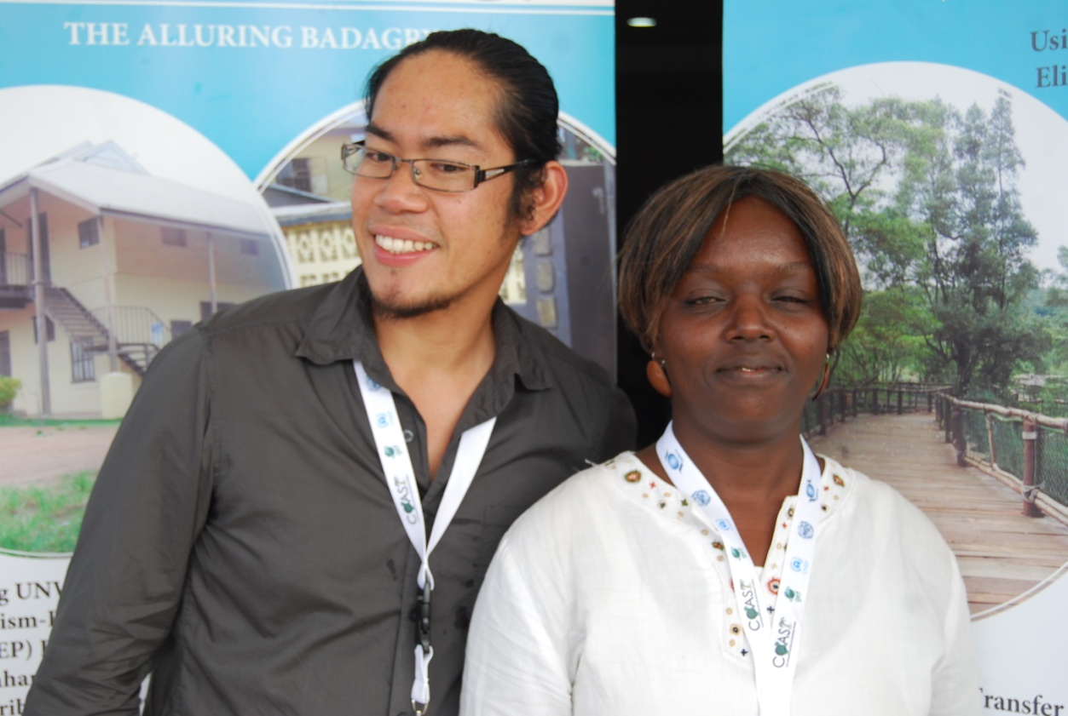
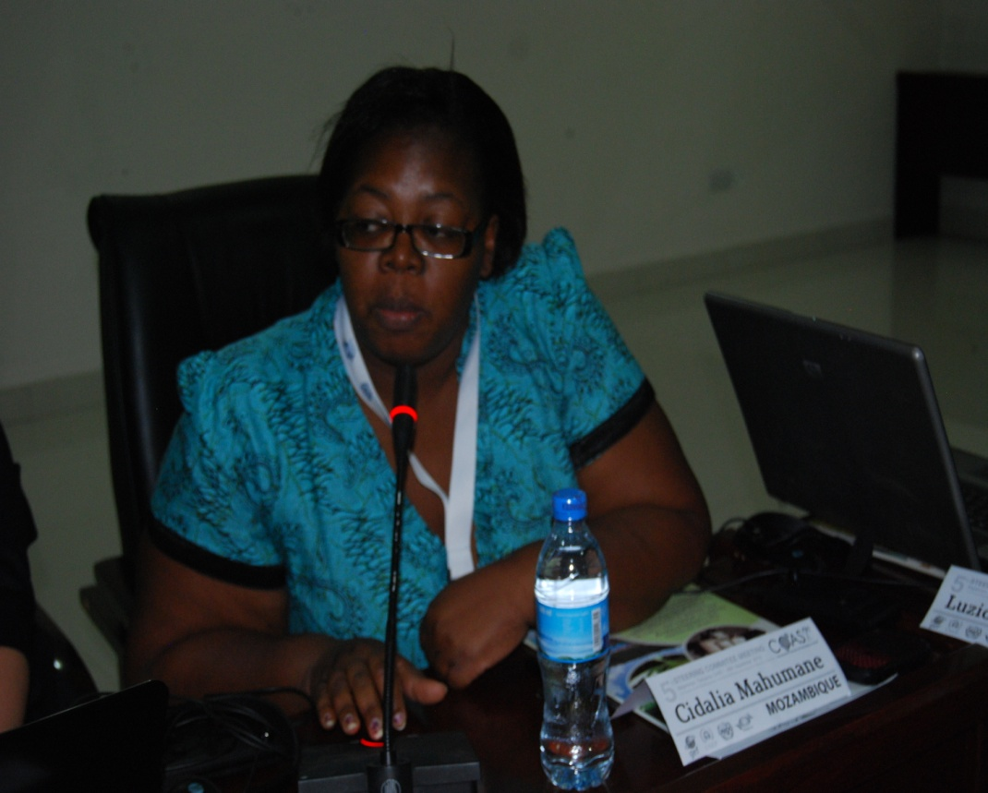

Slide 5
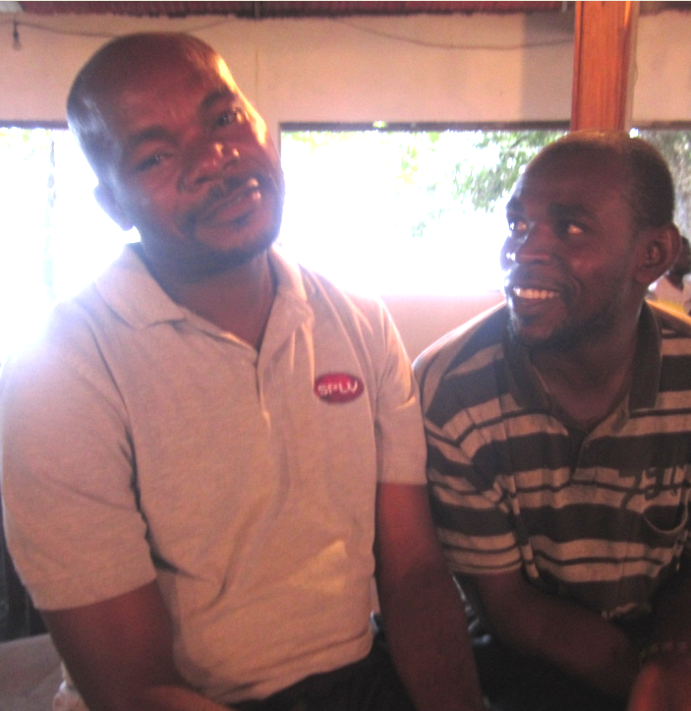
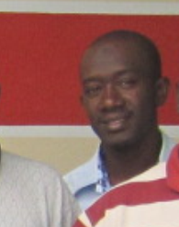
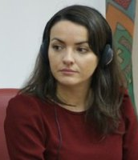
Photos still missing from Emelda, Liaision officers Ghana & Nigeria
and Nataliya (Marla to obtain photo from N)

Slide 6
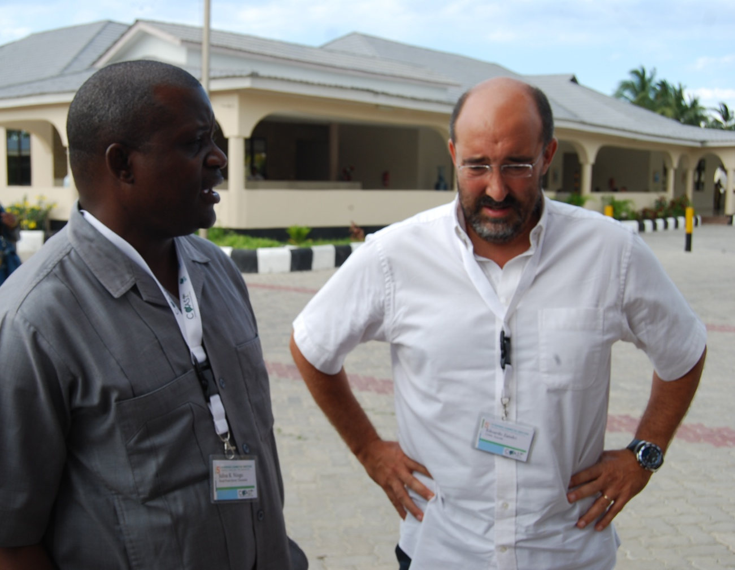
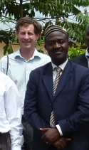
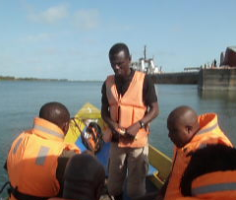
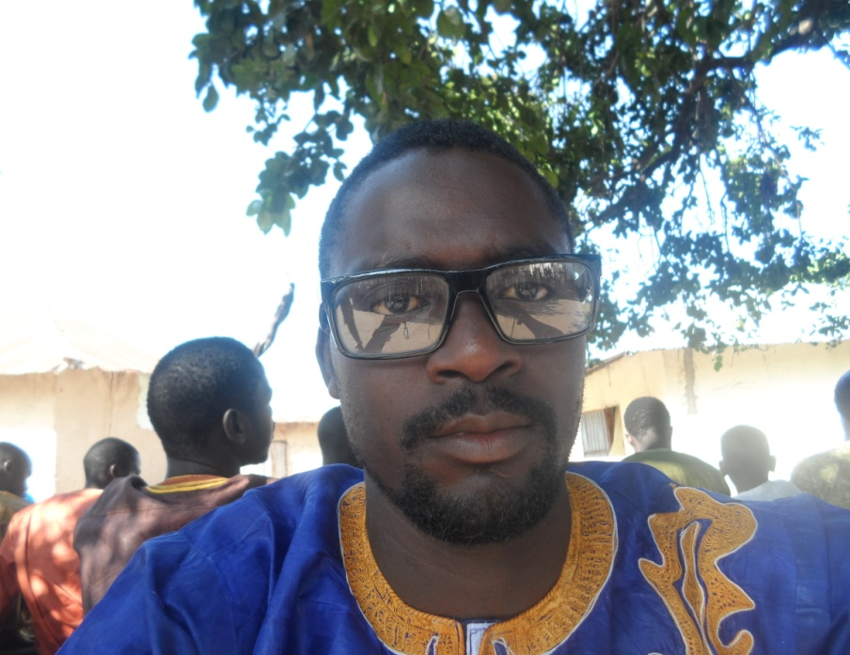
Photos still missing from Emelda, Liaision officers Ghana & Nigeria
and Nataliya (Marla to obtain photo from N)

Slide 7
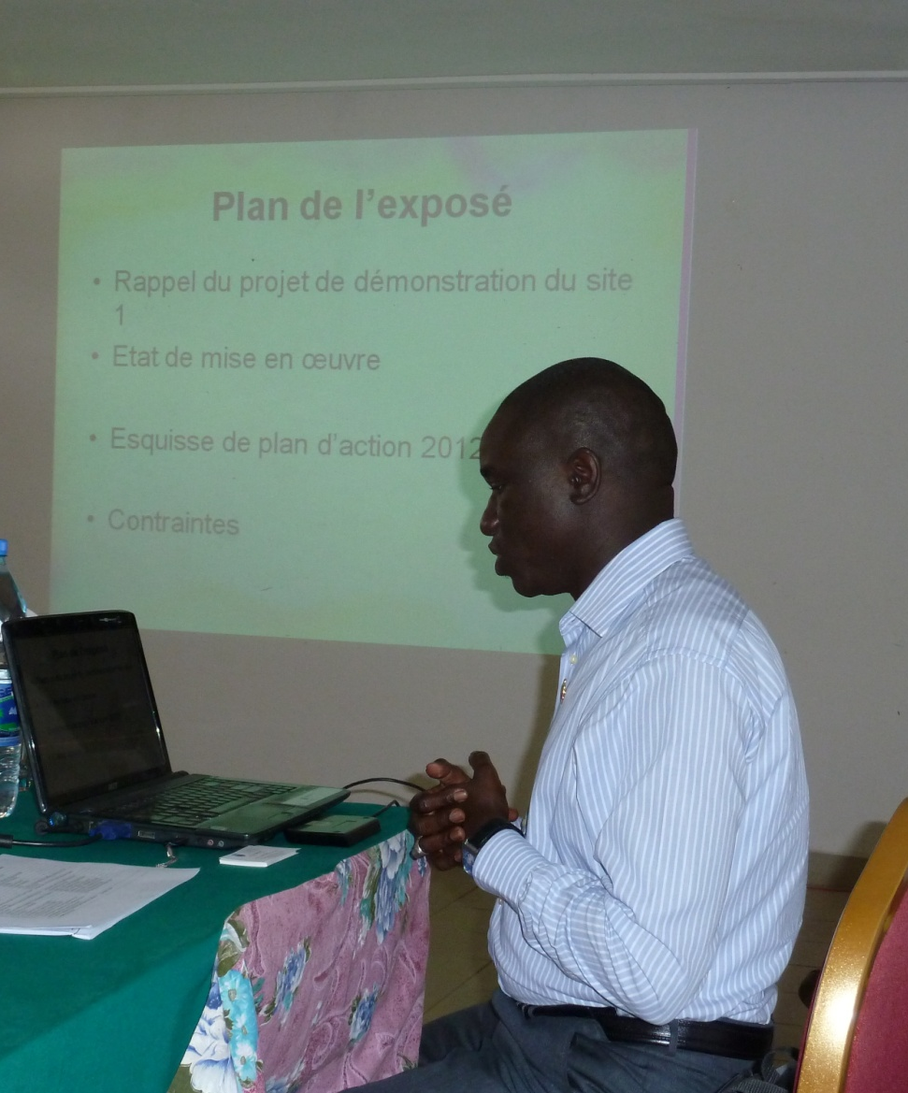
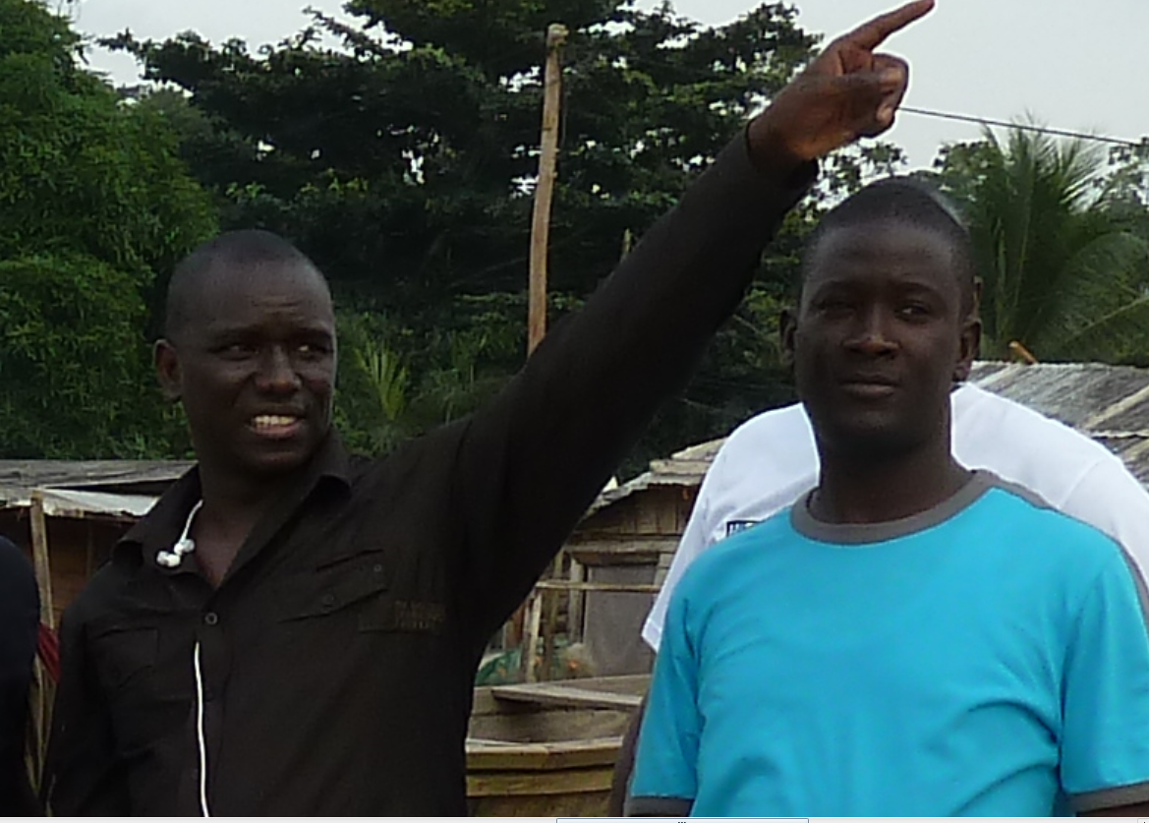
In memoriam
Babacar Sy, DPC Senegal

Slide 8
We are together!
Nous sommes ensemble!
Estamos todos juntos!

